Slide 1
TRAFFIC FORECASTING
UNIT 4

Slide 2
Reasons for Forecasts and Travel Analysis
TRAFFIC forecasting is the process of estimating the number of people or vehicles that will use a specific transportation facility in the future. TRAFFIC forecasts can be utilized in a variety of different situations and with different modes of transport, from estimating traffic volumes on a specific segment of road or highway to estimating ships in a port or passenger volumes on a city’s buses.

Slide 3
Forecasts explain what the needs of the future might be and provide benchmarks for proper design and efficient transportation system operation. TRAFFIC forecasts are fundamentally Important inputs in developing infrastructure – from developing overall transportation policy, to planning studies, to the engineering design of specific projects. Example applications of forecast information
include:

Slide 4
• Development of infrastructure capacity and design calculations (e.g., the operations of an existing or proposed roadway or bridge, or the thickness or type of roadway pavements)
• Estimation of the financial and/or social viability of projects (e.g., developing benefit-cost analyses and/or social impact assessments)
• Calculation of environmental impacts, such as air and noise pollution

Slide 5
The port planning process is generally designed to include a number of tasks which examine in turn the various aspects of the project in order to produce the overall port masterplan.

Slide 6
The masterplan (often in the form of a layout drawing) will define the future long-term development of the port area (often over the next 25 years) and also define the immediate requirements (often to be built in the next 5 years). .

Slide 7
Construction in the intervening period (of 20 years) will be timed to suit the speed of growth of the traffic being handled by the port but it will be generally in accordance with the masterplan so that all development is carried out in a planned and orderly fashion

Slide 8
The main steps in this process can generally be defined as follows, however this will be adjusted to suit the individual requirements of each project:-

Slide 9
Review of Existing Situation
This will generally include an inspection and report of the existing port facilities, the port equipment, staff and management, the types and volumes of cargo, the port tariffs and profitability. Study of port efficiency including cargo handling, stacking, customs and police procedures, may also be made. Land-use in and around the port site will be identified. In the case of a completely new port, alternative sites for port location will be identified.

Slide 10
Traffic Forecasts
The next step will be forecasting possible future traffic levels for the port. This may be done in a number of ways. At its simplest level a mere extrapolation of past trends may be used to estimate future growth. However this approach is likely to be over-simplistic and it is likely that macro-economic modelling will be carried out – this will reflect a number of additional factors such as the government’s long term development goals, global trends and business cycle effects.

Slide 11
The next step will be forecasting possible future traffic levels for the port. This may be done in a number of ways. At its simplest level a mere extrapolation of past trends may be used to estimate future growth. However this approach is likely to be over-simplistic and it is likely that macro-economic modelling will be carried out – this will reflect a number of additional factors such as the government’s long term development goals, global trends and business cycle effects.

Slide 12
Preparation of Preliminary Designs
This step essentially is a preliminary plan of how the port will need to develop from the existing situation in Step 1 to carry the traffic identified in Step 2. It will include assumptions on improvements in cargo handling rates and increases in ship sizes, thus leading to the required numbers and sizes of future berths. Ship queuing theory will be used to ensure ship waiting times (and therefore costs) are not excessive.

Slide 13
The required sizes of cargo stacking areas will be calculated. In parallel with this, the practicability of extending the port by the required amount will be examined, with new quays, breakwaters, dredged areas and storage areas proposed. Surveys may be required so that engineering designs can be prepared; this is likely to include topographic and bathymetric survey, borehole drilling and soil testing – we will specify, organise and supervise these.

Slide 14
We will also look at meteorological conditions – rainfall, winds which will affect ship berthing activities, waves, currents and sediment transport. This part of the study will tend to concentrate on the long term development, ensuring that the land (and sea) availability will be sufficient to allow the long term development of the port under the highest traffic forecast. A preliminary assessment of costs (with phasing) will also be made.

Slide 15

Port Operations
Complex chain of interacting events
  Approach channels
  Pilotage
  Immigration & checks
  Anchorage
  Vessel supplies
  Berthing space
  Cargo handling
  Storage space
  Gate clearance
  Inland transport network

Slide 16

Efficiency @ Port
Accomplishment of a job with a minimum expenditure of time and effort
Make best use of land, equipment and labor given geographical, physical and institutional constraints

Slide 17
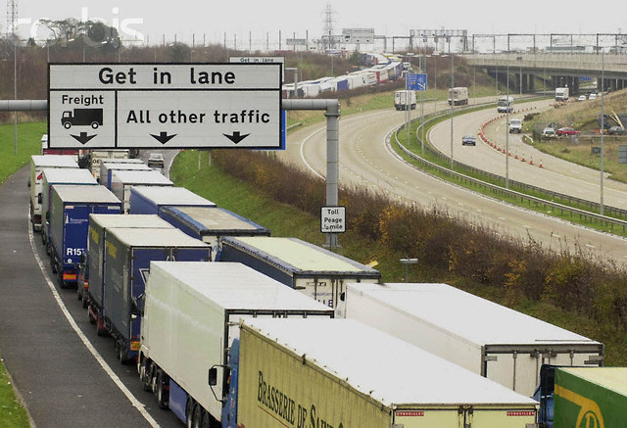
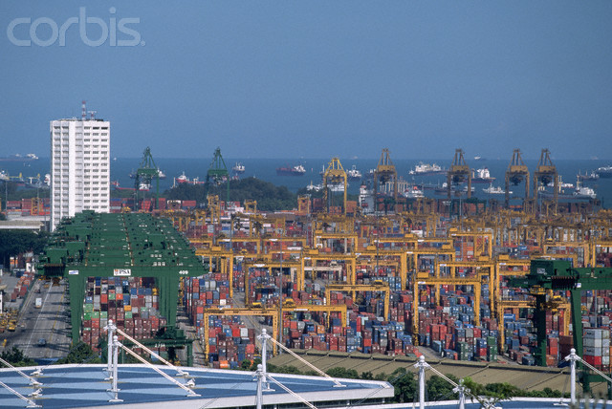
Efficiency @ Terminal
Berth vessel on arrival
Fast turnaround
  Adequate equipment and labor
  Ample storage space
  Supporting inland transport network
  Gate clearance
Timely Pilotage

Slide 18
Efficiency @ Terminal
Element of Terminal | Measure of Productivity | Measure
Crane | Crane Utilization Crane Productivity | TEUs/year per Crane Moves per Crane-Hour
Berth | Berth Utilization Service Time | Vessels/year per Berth Vessel Service Time (hrs)
Yard | Land Utilization Storage Productivity | TEUs/year per Gross Acre TEUs/Storage Acre
Gate | Gate Throughput Turnaround Time | Containers/hour/lane Truck Time in Terminal
Gang | Labor Productivity | Number of Moves/man-hour

Slide 19
Efficiency @ Terminal
Terminal Planning and Design
  Layout
  Capacity
  Equipment
Operations
  Space and resource allocation policies
    Berth
    Quay crane
    Trucks
    Yard space
    Yard crane
    Manpower
    Gate

Slide 20
Simulation
Computer model that mimics the operation of a real-world system over time
Problem-solving methodology for analyzing large and complex systems
Comprehensive way to quantify & demonstrate impact of critical supply chain decisions
Predict and understand the system’s behavior under wide variety of conditions

Slide 21
Simulation @ Port
Operations are complicated, with interacting factors and entail large amount of resources
Planning requires careful evaluation of various options
Conventional approach often based on static, heuristic rules that are not sufficiently rationalized and quantified
Need for more systematic approach to evaluate, plan and design terminals, keeping in mind synergies between different components

Slide 22
Simulation: Advantages
Ability to compare various scenarios once the base model has been formed
Compare alternate plans on an objective basis and without committing resources
Quantify impact of change without disrupting operations
Visualize the operations
Reduce uncertainty in decision making

Slide 23

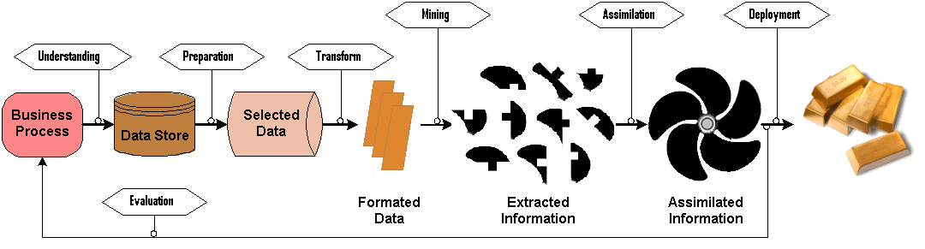
Data Mining
Extract from messy raw data useful information to improve business process and solve decision problems
Identify:
Design:
contributing factors to cost hike
hidden causes of performance drop
predictive rules
preventive measures
enhancement approaches
planning tools

Slide 24
Data Mining @ Port
Millions of TEUs / tonnes of cargo
Complicated chain of operations processes for handling cargo
Useful as a ‘post-mortem’ analysis to identify trends
Complements the use of simulation

Slide 25
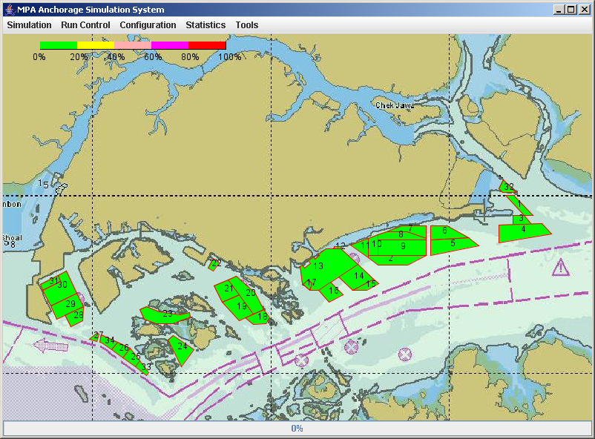
Enhancing Efficiency
Simulator for Traffic & Risk Assessment of Waters and Anchorages
Comprehensive historical data analysis of current marine traffic activities within port waters
Forecast arrivals and dwell time of vessels calling in future
Detailed realistic simulation model of vessel navigations and operations in port waterways
Assess traffic situation – capacity analysis
Assess traffic situation – risk assessment

Slide 26
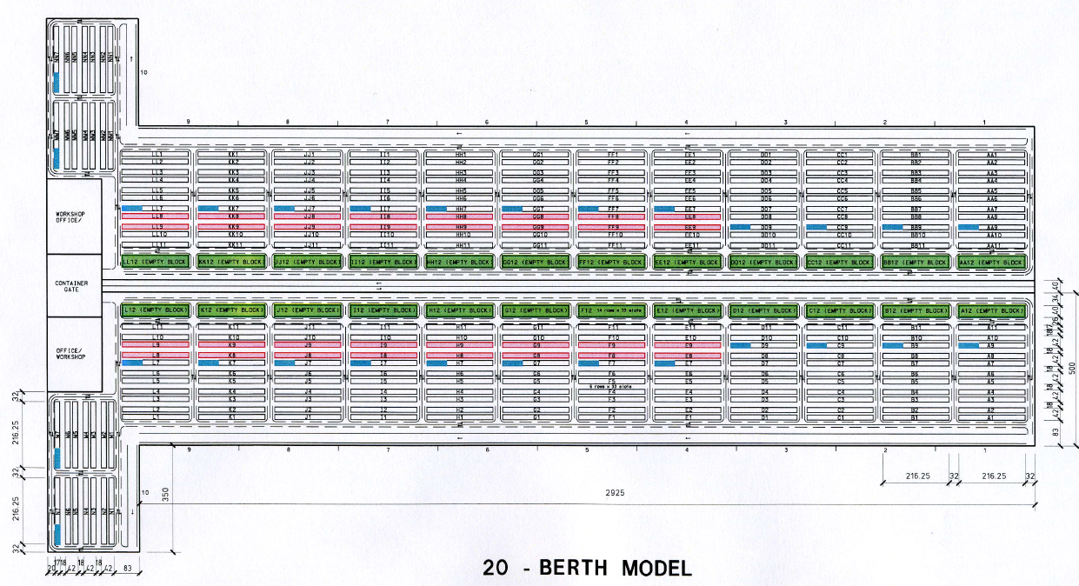
Enhancing Efficiency
Design and Capacity Planning for a New Port
Terminal Layout and Setup
Determine Required Storage Space
Capacity Estimation
Resource Requirement Estimation
Achievable Performance Estimation
Multi Operator Model
Efficient Servicing of Mega Vessels
Evaluate New Container Handling Technologies
Assessment of feasibility and utility of new envisioned concept

Slide 27
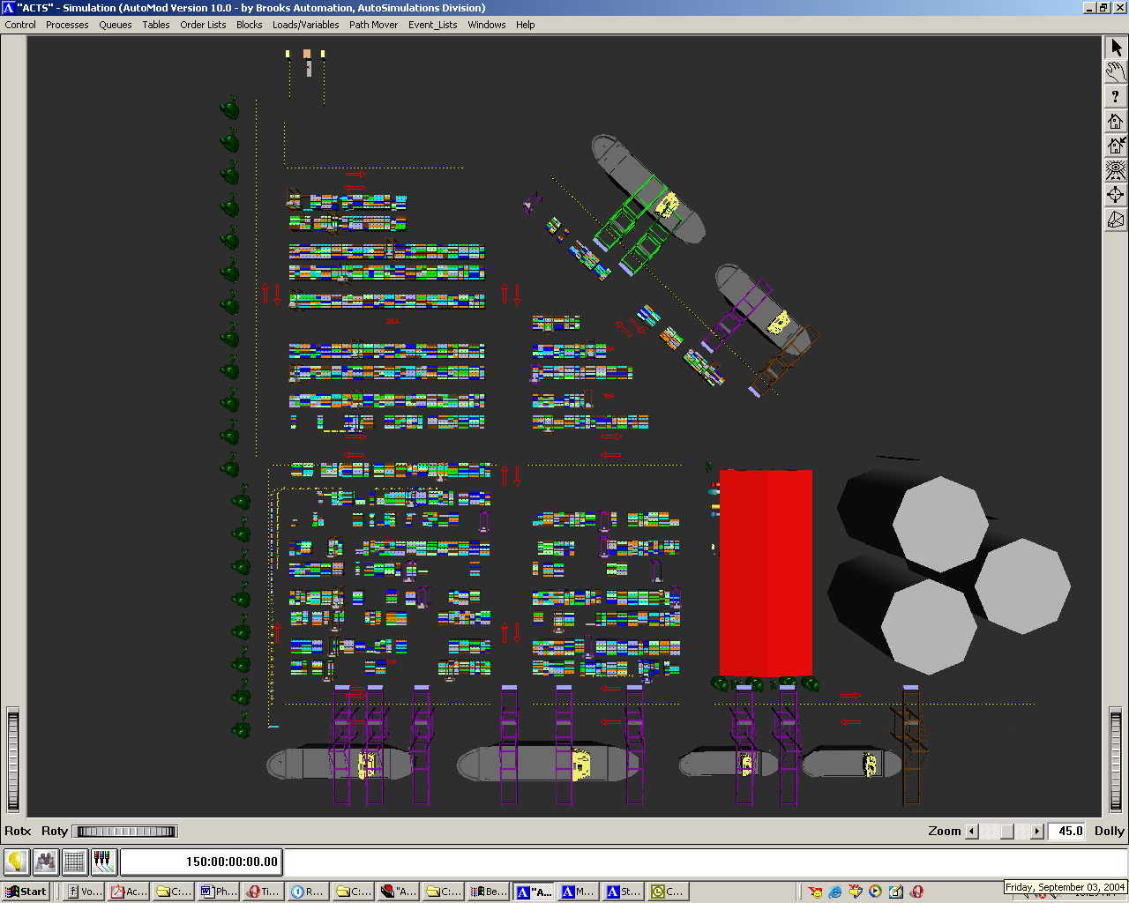
Enhancing Efficiency
Capacity Study and Operations Analysis
Terminal Capacity Estimation
Performance Evaluation
Bottleneck Detection
Implications to Operations for Achieving Higher Capacity
Recommendations for Increasing Capacity & Operational Efficiency
Guidelines for handling forecasted vessel and container volume
Terminal Capacity Estimation with Expansion
Resource Requirement Estimation

Slide 28
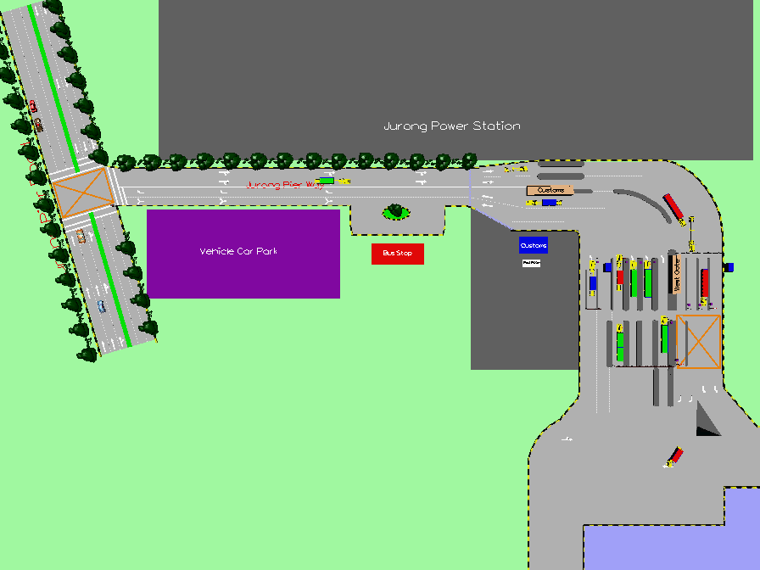
Enhancing Efficiency
Gate Design, Capacity and Performance Evaluation
Historical Gate and Trucking Performance Assessment
Gate Capacity Estimation
Gate Performance Statistics
Queuing Analysis and Sizing
Staffing
Evaluation of New Gate Layouts and Configurations
Suggest Requirements of Gate to Handle Target Volume

Slide 29
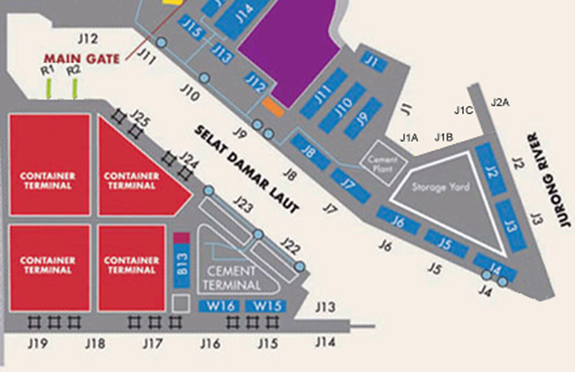
Enhancing Efficiency
Berth Capacity Study and Productivity Assessment
Future Traffic Forecasting
Berth Capacity Estimation
Productivity Assessment
Sustainability of Forecasted Traffic
Planning to Ensure Service Level Provided to Clients
Berth Expansion for Increased Capacity
Scenario Analyses

Slide 30
Challenges @ Port
Constantly evolve to face new challenges
  Increase in fuel costs
  Advent of Mega vessels
  Increasing pressure to adopt environment friendly policies and even threat of possible sanctions to be imposed
  New technology
  Competitor ports
  Change in global trade patterns and routes

