Slide 1
PORT OPERATION
UNITS 1

Slide 2
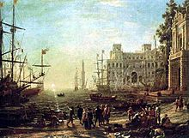
HISTORIC PORT

Slide 3
What is Port?
a town or city with a harbour or access to navigable water where ships load or unload.
A developed harbour.
Is a location on a coast or shore containing one or more harbour where ships can dock and transfer people or cargo to or from land. Port locations are selected to optimize access to land and navigable water, for commercial demand, and for shelter from wind and waves.

Slide 4
WHAT IS A PORT
The term port comes from the Latin word portus, which means gate or gateway.
Ports can be described as points of convergence between two domains of freight and passenger circulation, the land, air and maritime domains.

Slide 5
Historically, many ports emerged as safe harbors for fishing and those with convenient locations became trade hubs, many of which of free access and designed to protect trade. As such, they became nexus of urbanization with many becoming the first port cities. Today, many of the most important cities in the world owe their origin to their port location.

Slide 6
Fishing Port
A fishing port is a port or harbor for landing and distributing fish. It may be a recreational facility, but it is usually commercial. A fishing port is the only port that depends on an ocean product, and depletion of fish may cause a fishing port to be uneconomical. In recent decades, regulations to save fishing stock may limit the use of a fishing port, perhaps effectively closing it.

Slide 7
Historical Development of Kingston Port
The history of Kingston shows that the great harbour of Kingston, has created significant wealth over the years, quite apart from whatever economic regime may have been operating on the mainland. The Port of Kingston has always been the hub of trade with several periods governing its development:

Slide 8
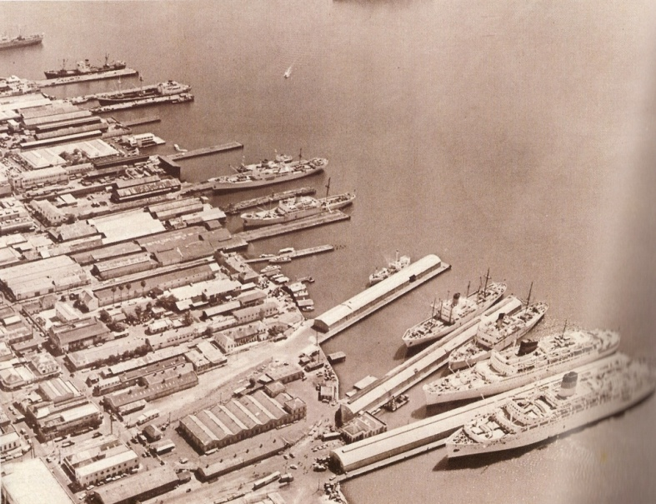
In the Beginning
Finger Piers of Downtown Kingston in the early 1900s
Photo Source: SAJ Archive
8
Notes:
Established 1945
Four Finger Piers – Princess, Orange, Hanover and East Streets
In the nineteenth century, Kingston was a major port of call for trans Atlantic vessels despite the limited port facilities.
The finger piers became obsolete in the twentieth century

Slide 9
1692-1713 - The early freebooters British Governments, Jamaican Governors, pirates, buccaneers and privateers plundered and brought fortunes to Kingston to finance imports from North America and Britain.
1713-1759 -The Asiento Trade When the British got exclusive right to supply Spanish America with some products, Jamaican planters objected to the competition, but trade developed earning vast sums for the port and created fortunes in Britain.

Slide 10
1766-1822 - Kingston as a Freeport During this period, Kingston was said to be among the principal ports in the Western Hemisphere, and the main source of coins for the British Empire.
1860-1912 - Opening of Central America When it was decided to cut a canal across the Isthmus of Central America, Kingston became a primary source of supply of labour for the canals, railways, and the introduction of banana cultivation by American companies who found Jamaica too small for their operations. This trade brought new influences into Jamaica – George Stiebel from Venezuela and Cecil Lindo from Costa Rica.

Slide 11
1939-1944 – WWII With the closure of the Atlantic merchant shipping lanes, Kingston port flowered into a range of activities as a new coastal trade was renewed among Jamaican ports; and small boats started trading with other Caribbean ports as new sources of goods were sought.

Slide 12
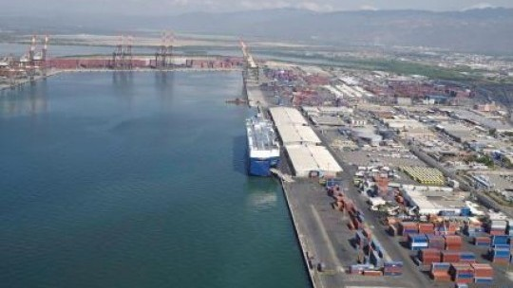
Transition between General Cargo and Transshipment

Slide 13
Role Of Ports in Marine Transportation
Maritime transport is the shipment of goods (cargo) and people by sea and other waterways. Port operations are a necessary tool to enable maritime trade between trading partners. To ensure smooth port operations and to avoid congestion in the harbor it is inevitable to permanently upgrade the port’s physical infrastructure, invest in human capital, fostering connectivity of the port and upgrade the port operations to prevailing standards.

Slide 14
Hence, port operations can be defined as all policies, reforms and regulations that influence the infrastructure and operations of port facilities including shipping services

Slide 15
More than 80% of world trade is carried by sea, constituting by far the most important means of transport of goods. Maritime transport has been growing annually by around 3.1% for the past three decades. Although there are many shipping companies in the maritime industry, most of them are small with insignificant market shares. For example, 52% of the world TEU capacity in 2012 was provided by the top 10 largest service operators.

Slide 16
The top 3 (Maersk Line, Denmark; MSC, Switzerland; and the CMA-CGM Group, France) supply a total of 5,291,145 TEU, approximately 30% of the world’s total TEU capacity. Even though the largest shipping companies are located in developed economies their fleets are by large registered in developing countries. Panama and Liberia, the two leading registries account for one third of the world’s deadweight tonnage.

Slide 17
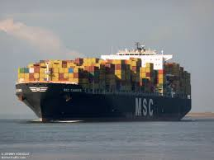
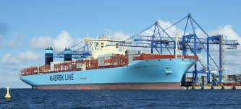
MAJOR LINES

Slide 18
EARLY DEVELOPMENT
Before the industrial revolution, ships were the most efficient means of transporting goods, and thus port sites were frequently chosen at the head of water navigation, that is the most upstream site.
Conventionally, port terminals where located close to city cores as in many instances the port itself was the initial rationale for the existence of the city.
The proximity to downtown areas also ensured that there was a large pool of workers availability to perform the labour intensive task of loading and unloading the ships

Slide 19
EARLY DEVELOPMENT
Many major cities, such as London on the Thames, Montreal on the St. Lawrence River or Guangzhou on the Pearl River owed their early pre-eminence to this fact.

Slide 20
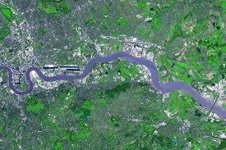
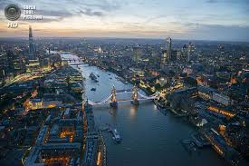
River Thames from two different views

Slide 21
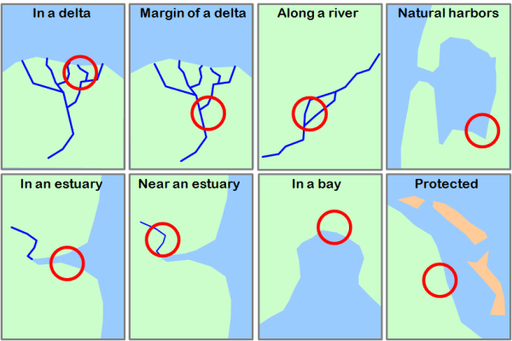
PORT LOCATIONS

Slide 22
Typical Location of Ports
Port Sites
There is a vast array of port sites linked to varied nautical profiles, some of these are:
Mainland Ports. These ports are linked to a major river, which is often serving a vast hinterland. These comprise of ports in a delta (New Orleans, Bangkok); at the margin of a delta (Calcutta, Rangoon, and Rotterdam); in an estuary (Le Havre, New York, Buenos Aires); near an estuary (Liverpool, Lisbon, Quebec) or along a river (Montreal, Antwerp, Portland).
For instance, one of the oldest ports in the world, Ostia, was at the mouth of the Tiber river and acted as Rome's port.

Slide 23
Typical Location of Ports
Seaports. These ports have direct access to the sea. They are in bays (Tokyo), natural harbors (San Francisco, Rabaul), or protected locations (Gdansk: sand dunes, Dakar: islands, Honolulu: reefs).

Slide 24
Types of Harbours
Coastal Natural – example port Of Kingston Jamaica
Coastal Breakwater – eg. Cherbourg France
Coastal Tide Gate – Mumbai India
River Tide Gate- eg Bremerhaven, Germany
Canal or Lake – eg. Brugge Belgium
River Natural – eg. Jacksonvill, Florida
Open Roadstead- eg. Persian Gulf
River Basin – eg Bremen Germany
Notes:
Represents a sheltered site the outcome of a natural profile of the coast, creating a natural barrier such as a cape, a reef or an island. The harbor of Kingston, Jamaica is an example of this type of harbor and about 2,100 (46.0%) ports fall in this category.
This underlines the fact that the selection of a port site is dominantly influenced by the quality of the harbor.
An harbor lying behind an artificial breakwater construction, built from scratch or built to add to an existing natural shelter. It is particularly the case for harbors exposed to dominant winds, waves or the sea currents. Cherbourg, France is an example of this type of harbor.
An harbor behind a set of locks or other mechanical devices built to ensure sufficient water levels are in the harbor for all tide levels. In many cases ships can enter or exit the port only at certain times of the day when water levels are adequate.
An harbor located along a river where water is not retained in any artificial means. The harbor often consists of quays or wharves parallel to the river banks. Piers may also extend into the river.
An harbor with no natural or artificial protection. They are often built to accommodate very large ships (such as oil tankers) or are in a setting where there are limited tides, implying that the sheltering of the infrastructure is less required

Slide 25
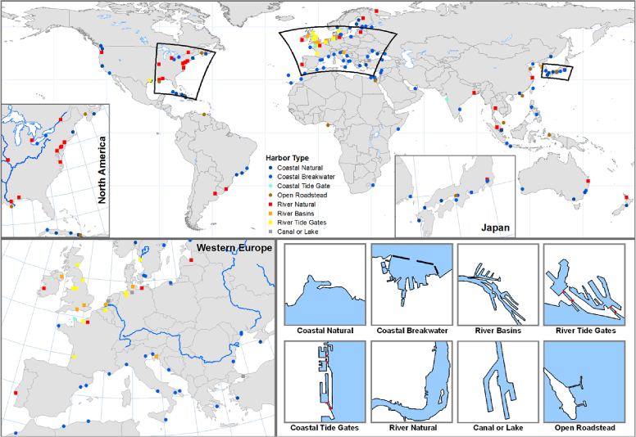
TYPES OF HARBOUR

Slide 26
STRATEGIC ROLES OF PORTS

Slide 27
Why is a port considered to be strategic?

Slide 29
Strategic role
The Port of San Diego plays an important role when it comes to National Security: it is one of only 17 strategic commercial seaports in the United States.
"Our Port's marine terminals are important for their ability to support commercial cargo, yet they also play a vital role in terms of our nation's defense," said Lou Smith, Chairman of the Board of Port Commissioners.
The Port of San Diego is the fourth largest port in California. Its maritime terminals provide the infrastructure and services necessary to support military deployment activities, which can range from getting vehicles and equipment where it needs to go, to shipping household goods to servicemen and their families.

Slide 30
Strategic ctd
"In the last two years, 18.4 million pounds of unit cargo has gone through the Tenth Avenue Marine Terminal and the National city marine terminal," said Rear Admiral Dixon R. Smith, Commander of the Navy Region Southwest. "That ranks the Port of San Diego, as a strategic port, as the number one Strategic Port on the West Coast."
The Port had to undergo a stringent testing and requirements process before being designated a strategic port in 1995 by the U.S. Department of Transportation Maritime Administration (MARAD).
The criteria used during the requirements process included:

Slide 31
Deepwater Infrastructure
Intermodal Connections (access to railroads, freeways, and highways)
Geographic Location (San Diego is home to Naval Base San Diego)
Covered and Uncovered Storage Facilities
High Security at Tenth Avenue and National City Marine Terminals

Slide 32
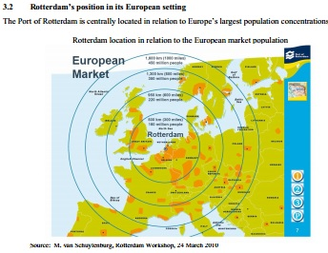

Slide 33
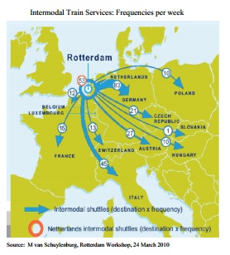

Slide 34
Commercial Role of Ports

Slide 35
Commercial role of ports
A terminal may be defined as any facility where passengers and freight are assembled or dispersed. Both cannot travel individually, but in batches. Passengers have to go to bus terminals and airports first, where they are "assembled" in busloads or planeloads to reach their final destinations where they are dispersed. Freight has to be consolidated at a port or a rail yard before onward shipment

Slide 36
Commercial continued
Terminal. Any location where freight and passengers either originates, terminates, or is handled in the transportation process. Terminals are central and intermediate locations in the movements of passengers and freight. They often require specific facilities and equipment to accommodate the traffic they handle

Slide 37
Commercial ctd
Terminals may be points of interchange within the same modal system and which insure a continuity of the flows. This is particularly the case for modern air and port operations with hubs connecting parts of the network. Terminals, however, are also very important points of transfer between modes. Buses and cars deliver people to airports, trucks haul freight to rail terminals, and rail brings freight to docks for loading on ships. One of the main attributes of transport terminals, international and regional alike, is their convergence function.

Slide 38
Commercial ctd
With one exception, passenger terminals require relatively little specific equipment. This is because individual mobility is the means by which passengers access busses, ferries or trains. Certainly, services such as information, shelter, food and security are required, but the layouts and activities taking place in passenger terminals tend to be simple and require relatively little equipment. They may appear congested at certain times of the day, but the flows of people can be managed successfully with good design of platforms and access points, and with appropriate scheduling of arrivals and departures.

Slide 39
Commercial ctd
Freight handling requires specific loading and unloading equipment. In addition to the facilities required to accommodate ships, trucks and trains (berths, loading bays and freight yards respectively) a very wide range of handling gear is required that is determined by the kinds of cargoes handled. Freight transport terminals have a set of characteristics linked with core (terminal operations) and ancillary activities (added value such as distribution). The result is that terminals are differentiated functionally both by the mode involved and the commodities transferred.

Slide 40
Commercial ctd
Bulk refers to goods that are handled in large quantities that are unpackaged and are available in uniform dimensions. Liquid bulk goods include crude oil and refined products that can be handled using pumps to move the product along hoses and pipes. Relatively limited handling equipment is needed, but significant storage facilities may be required. Dry bulk includes a wide range of products, such as ores, coal and cereals. More equipment for dry bulk handling is required, because the material may have to utilize specialized grabs and cranes and conveyer-belt systems.

Slide 41
Commercial ctd
General cargo refers to goods that are of many shapes, dimensions and weights such as machinery, processed materials and parts. Because the goods are so uneven and irregular, handling is difficult to mechanize. General cargo handling usually requires a lot of labor.

Slide 42
Commercial ctd
Containers are standard units that have had a substantial impact on terminal operations. Container terminals have minimal labor requirements and perform a wide variety of intermodal functions. They however require a significant amount of storage spaces which are simple paved areas where containers can be stacked and retrieved with intermodal equipment (cranes, straddlers and holsters). Depending on the intermodal function of the container terminal, specialized cranes are required, such as portainers (container cranes). Intermodal terminals and their related activities are increasingly seen as agents of added value within supply chains.

Slide 43
Economic Impact of ports

Slide 44
Economic impact of ports
Activities in transport terminals represent not just exchanges of goods and people, but constitute an important economic activity. Employment of people in various terminal operations represents an advantage to the local economy. Dockers, baggage handlers, crane operators and air traffic controllers are example of jobs generated directly by terminals. In addition there are a wide range of activities that are linked to transportation activity at the terminals..

Slide 45
These include the actual carriers (airlines, shipping lines etc.) and intermediate agents (customs brokers, freight forwarders) required to carry out transport operations at the terminal. It is no accident that centers that perform major airport, port and rail functions also important economic poles

Slide 46
What are the economical impacts of building a port ?

