Slide 1
MICRO-ECONOMICS
UNIT TWO
INTRODUCTION TO DEMAND & SUPPLY ANALYSIS

Slide 2
DEFINITION OF DEMAND & QUANTITY {AGGREGRATE} DEMAND
DEMAND is the amount of a particular
economic good or service that a consumer or
group of consumers will want to purchase at a
given price over a given period {usually one
year}.

Slide 3
QUANTITY {AGGREGRATE} DEMAND
A term used in economics to describe the total
amount of goods or services that are demanded at
any given point in time. The quantity demanded
depends on the price of a good or service in the
marketplace, regardless of whether that market is
in equilibrium. The quantity demanded is
determined at any given point along a demand
curve in a price vs. quantity plane.

Slide 4
LAW OF DEMAND
As the price of goods and services increase, demand for same decrease. The opposite is true. That is Price and demand are inversely related.

Slide 5
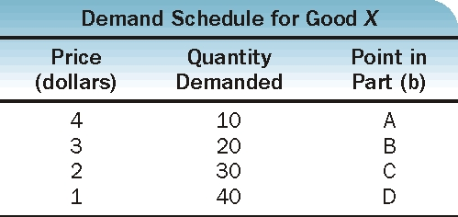
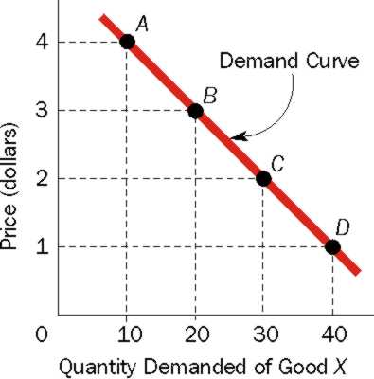
Individual Demand Curve & Demand Schedule
(a)
(b)

Slide 6
Price and Quantity Demanded: The Law of Demand
The demand curve is a graph illustrating how much of a given product a household would be willing to buy at different prices.

Slide 7
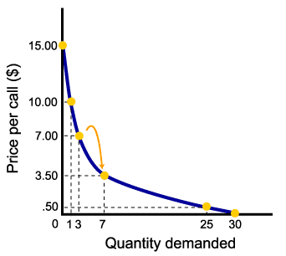
Price and Quantity Demanded: The Law of Demand

Slide 8
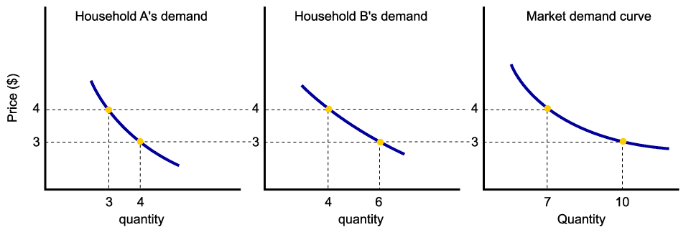
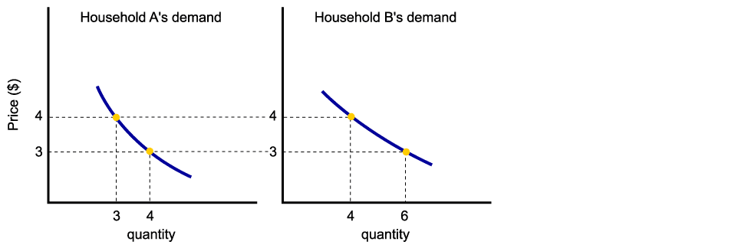
From Household Demand to Market Demand
Assuming there are only two households in the market, market demand is derived as follows:

Slide 9
Factors Influencing the Demand Curve
Price of goods & services
Income
Taste & Preferences
Prices of Related Goods
Number of Buyers
Expectations of Future Price

Slide 10
Movement along the Demand Curve
(a)
(b)

Slide 11
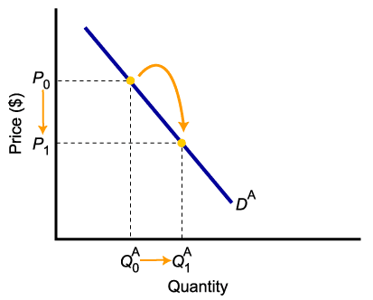
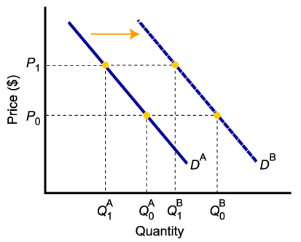
A Change in Demand Versus a Change in Quantity Demanded
To summarize:
Change in price of a good or service
leads to
Change in quantity demanded (Movement along the curve).
Change in income, preferences, or prices of other goods or services
leads to
Change in demand (Shift of curve).

Slide 12
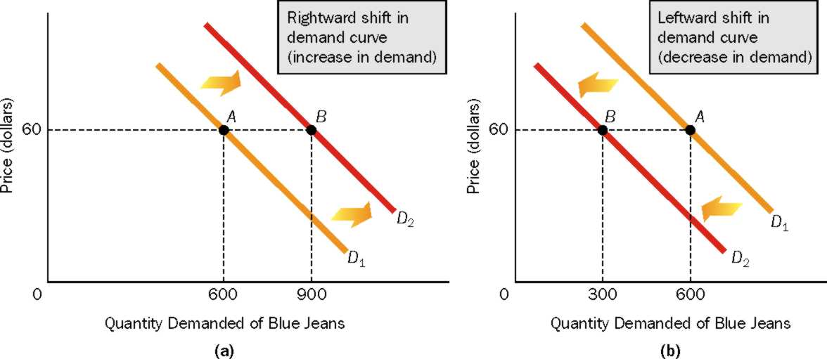
Shifting the Demand Curve
A change in Demand causes a shift in the Demand curve.
A change in the Quantity Demanded moves a point along the current Demand curve.
If Demand increases, the curve shifts to the right.
If Demand decreases, the curve shifts to the left.

Slide 13
SUPPLY & QUANTITY SUPPLY

Slide 14
SUPPLY
The total amount of a product (good or service) available for purchase at any specified price.

Slide 15
SUPPLY IN PRODUCT/OUTPUT MARKETS
Quantity supplied represents the number of units of a product that a firm would be willing and able to offer for sale at a particular price during a given time period.
A supply schedule is a table showing how much of a product firms will supply at different prices.

Slide 16
THEORY OF SUPPLY
The law of supply states that there is a positive relationship between price and quantity of a good supplied.
This means that supply curves typically have a positive slope.

Slide 17
FIRM & MARKET SUPPLY CURVES
A supply curve is a
graph illustrating
how much of a
product a firm will
supply per period of
time at different
prices.

Slide 18
From Individual Supply to Market Supply
As with market demand, market supply is the horizontal summation of individual firms’ supply curves.

Slide 19
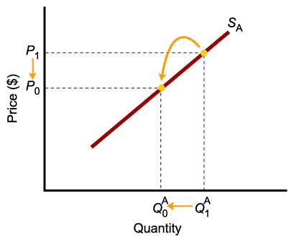
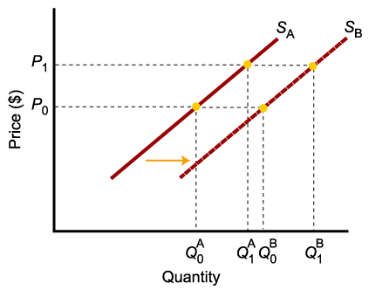
Shift of Supply Versus Movement Along a Supply Curve
To summarize:
Change in price of a good or service
leads to
Change in quantity supplied (Movement along the curve).
Change in costs, input prices, technology, or prices of related goods and services
leads to
Change in supply (Shift of curve).

Slide 20
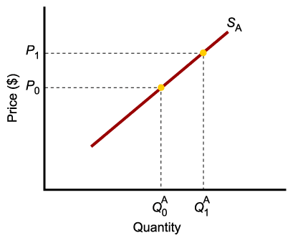
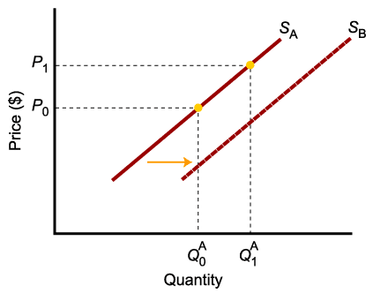
Shift of Supply Versus Movement Along a Supply Curve
A higher price causes higher quantity supplied, and a move along the demand curve.
A change in determinants of supply other than price causes an increase in supply, or a shift of the entire supply curve, from S_{A} to S_{B}.

Slide 21
DETERMINATION OF MARKET PRICE, EQUILIBRIUM PRICE, IMPACT OF CHANGES IN DEMAND & SUPPLY

Slide 22
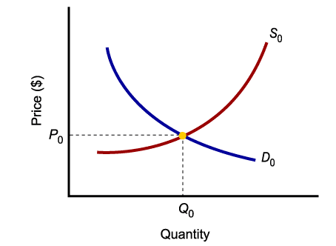
Market Equilibrium
MARKET EQUILIBRIUM IS THE CONDITION THAT EXISTS WHEN QUANTITY SUPPLIED AND QUANTITY DEMANDED ARE EQUAL.
AT EQUILIBRIUM, THERE IS NO INCENTIVE FOR THE MARKET PRICE TO CHANGE.

Slide 23
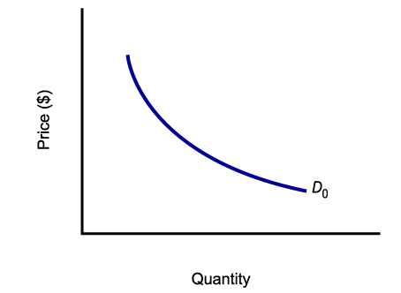
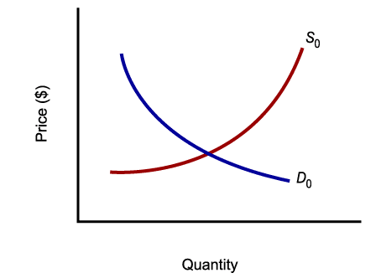
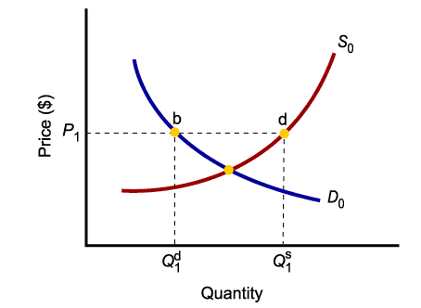
MARKET EQUILIBRIUM
Only in equilibrium is quantity supplied equal to quantity demanded.
At any price level other than P₀, such as P₁, quantity supplied does not equal quantity demanded.

Slide 24
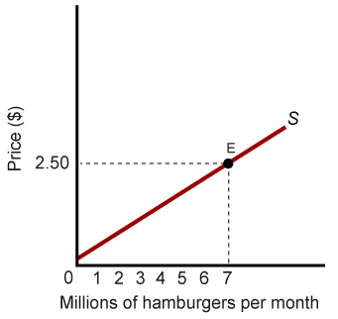
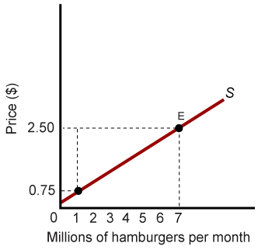
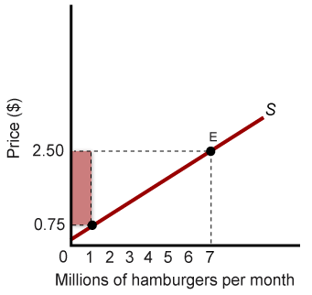
PRODUCER SURPLUS
Some producers are willing to accept as little as 75 cents each for hamburgers.
Since the price is $2.50, they receive a producer surplus of $1.75 per hamburger.

Slide 25
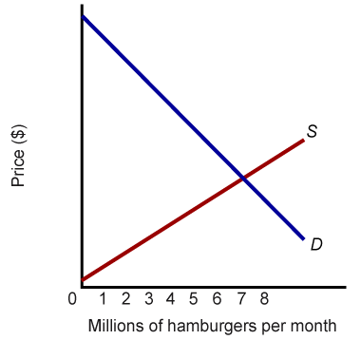
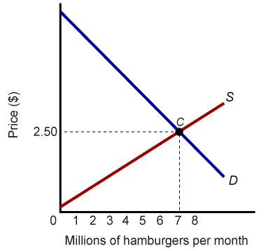
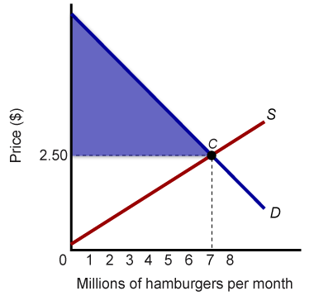
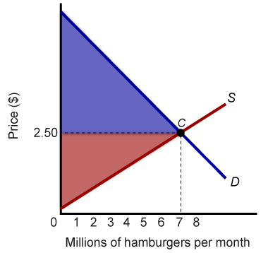
Markets Maximize the Sum of Producer and Consumer Surplus
Total producer and consumer surplus is highest where supply and demand curves intersect at equilibrium.
Consumers receive benefits in excess of what they pay and producers receive compensation in excess of costs.

Slide 26
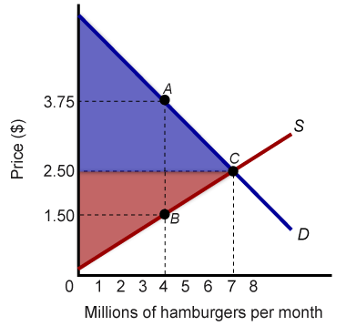
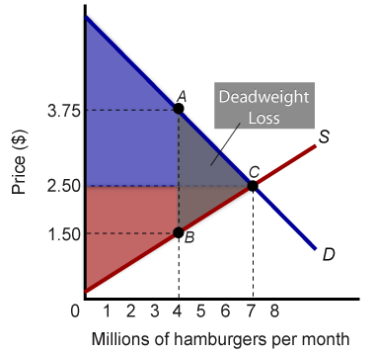
Markets Maximize the Sum of Producer and Consumer Surplus
If the market produces too little, say 4 million instead of 7 million hamburgers per month, total producer and consumer surplus is reduced. This reduction (triangle ABC) is called a deadweight loss.

Slide 27
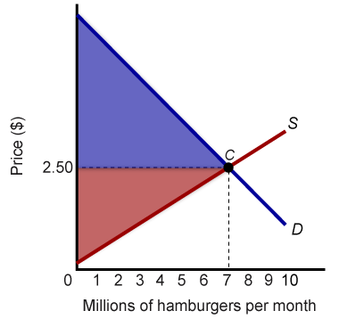
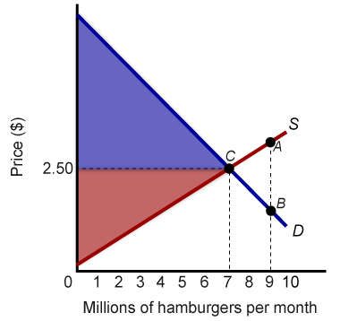
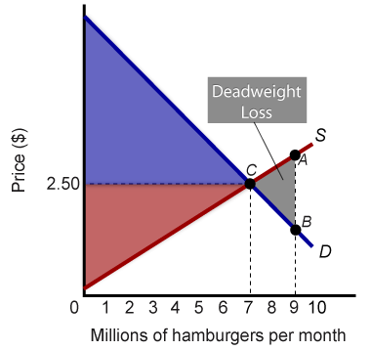
Potential Causes of Deadweight Loss From Under- and Overproduction
Deadweight losses can occur from under- and overproduction.
If the market produces 10 million instead of 7 million hamburgers per month, the cost of production rises above the willingness of consumers to pay, resulting in a deadweight loss.

Slide 28
DISCUSSION QUESTIONS
1. The following are some changes that may take place in the market for
textbooks. For each of the following, indicate with a diagram what will
happen to either the demand for or the supply of textbooks by listing
which curve is affected and how it will be affected.
(a.) An increase in student enrollment at universities across the country.
(b.) A decrease in the price of ink used to print textbooks.
(c.) A drop in income (textbooks are a normal good).
(d.) An improvement in the technology used to print textbooks.
(e.) An increase in college tuition.

Slide 29
2. The figure below shows the market for macaroni:

Slide 30
Question 2. continues
a. What is the equilibrium price and quantity?
b. At what prices shown on the graph would there be an excess demand for macaroni? What would be the size of this excess demand?
c. At what prices shown on the graph would there be an excess supply of macaroni? What would be the size of this excess supply?

Slide 31
THE END
THANKS

