Slide 1
MICRO-ECONOMICS
UNIT ONE
THE NATURE OF ECONOMICS

Slide 2
THE NATURE OF ECONOMICS

Slide 4
WHAT IS ECONOMICS?
Economics is the study of the production and
consumption of goods and the transfer of
wealth to produce and obtain those goods.
Economics explains how people interact
within markets to get what they want or
accomplish certain goals. Since economics is a
driving force of human interaction, studying it
often reveals why people and governments
behave in particular ways.

Slide 6
BRANCHES OF ECONOMICS
There are eight {8} main types of economics:
Macroeconomics also called Aggregative Economics.
Microeconomics
International economics
Public finance
Development economics
Health economics
Environmental economics
Urban and rural economics

Slide 7
Micro-Economics focuses on the actions of an
individual unit. It is the study of one
particular unit rather than all the units
combined.
Macro-Economics on the other hand, takes a
much broader view by analyzing the economic
activity of an entire country or the
international marketplace.

Slide 9
International economics: As the countries of
the modern world are realizing the
significance of trade with other countries, the
role of international economics is getting more
and more significant nowadays.
Public finance: The great depression of the
1930s led to the realization of the role of
government in stabilizing the economic growth
besides other objectives like growth,
redistribution of income, etc.

Slide 10
Development economics: As after the Second
World War many countries got freedom from
the colonial rule, their economics required
different treatment for growth and
development. This branch developed as
development economics.
Health economics: A new realization has emerged
from human development for economic growth.
Therefore, branches like health economics are
gaining momentum.

Slide 11
Environmental economics: Unchecked
Emphasis on economic growth without caring
for natural resources and ecological balance,
now, economic growth is facing a new
challenge from the environmental side.
Therefore, Environmental Economics has
emerged as one of the major branches of
economics that is considered significant for
sustainable development.

Slide 12
Urban and rural economics: Role of location is
quite important for economic attainments.
There is also much debate on urban-rural divide.
Therefore, economists have realized that there
should be specific focus on urban areas and
rural areas. Therefore, there is expansion of
branches like urban economics and rural
economics. Similarly, regional economics is also
being emphasized to meet the challenge of
geographical inequalities

Slide 13
BASIC ECONOMICS CONCEPTS
SCARCITY
CHOICE
OPPORTUNITY COST
PRODUCTION POSSIBILITY FRONTIER

Slide 14
SCARCITY, CHOICE & RESOURCE ALLOCATION
Scarcity is the condition in which our wants are greater than the limited resources available.
Due to scarcity, choices in terms of how the scarce resources must be allocated have to be made.

Slide 15
SCARCITY, CHOICE & RESOURCE ALLOCATION
By making choices, by allocating scarce resources, opportunity cost will be incurred.
Opportunity costs—revenue given up as a result of not selecting the next best alternative.

Slide 16
TRADE & TRADEOFF
With the allocation of scarce resources, trade and trade off will no doubt take place.
PRODUCTION POSSIBILITES CURVE

Slide 17
The Production Possibilities Frontier (PPF)
The PPF is a graph representing the
possible combinations of two goods that
an economy can produce in a certain
period of time under the conditions of a
given state of technology, no unemployed
resources and efficient production.

Slide 18
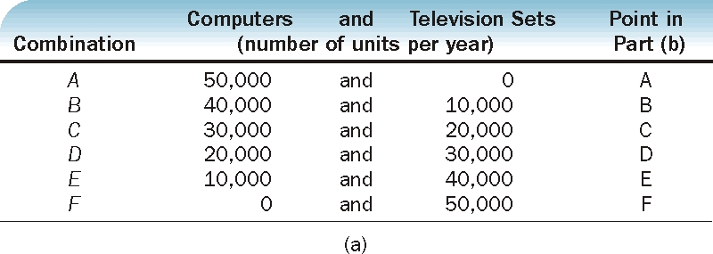
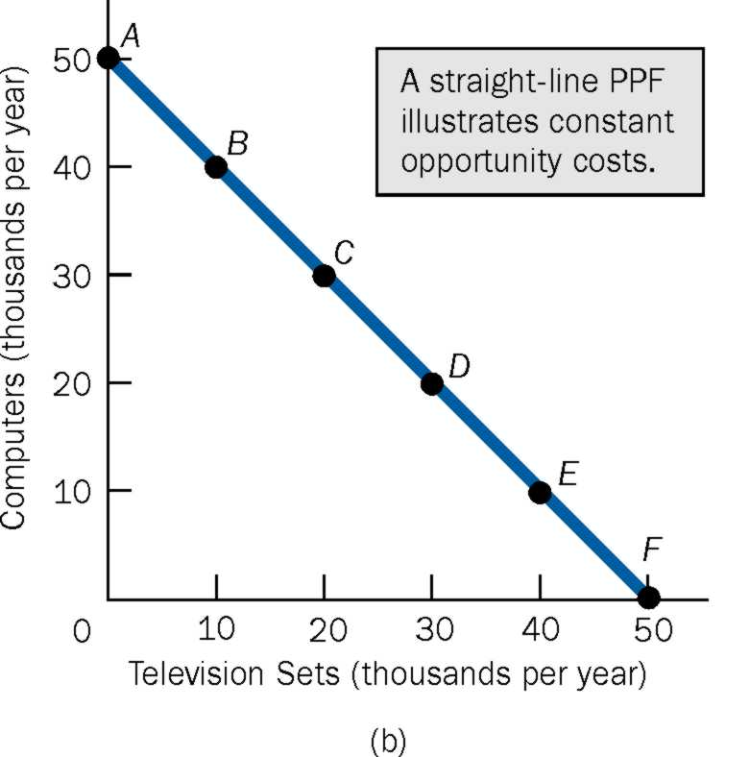
Straight Line PPF: Constant Opportunity Costs

Slide 19
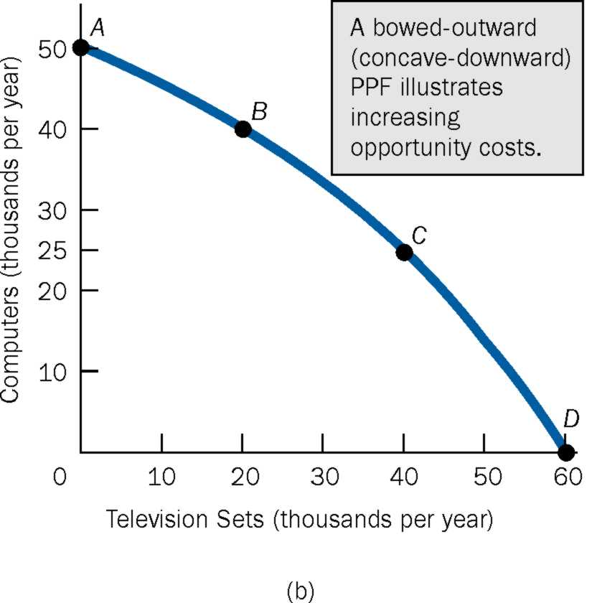
Bowed Outward PPF: Increasing Opportunity Costs

Slide 20
ECONOMICS SYSTEMS

Slide 22
MERITS & DEMERITS OF CAPITALISM

Slide 23
SOCIALISM

Slide 24
MIXED ECONOMY

Slide 25
DISCUSION QUESTIONS
1. Use a graph and comment on the following statement: "If an economy is producing inside its production possibilities frontier, it could possibly
produce more of one good without giving up any of the other."

Slide 26
THE END
THANKS

