Slide 1
MACRO-ECONOMICS
Presenter: Kirkland Anderson
Associate Professor of Economics & Management

Slide 2
UNIT ONE
NATIONAL INCOME ACCOUNTING

Slide 3
NATIONAL INCOME
National income is a measure of the monetary
value of the flow of output of goods and
services produced in an economy over a
period of time.
Measuring the level and rate of growth of
national income (Y) is important for seeing:

Slide 4
The rate of economic growth
Changes to average living standards
Changes to the distribution of income between groups within the population

Slide 5
NATIONAL INCOME {GDP}
Total income earned by the factors of production.
Land
Labor
Capital
Entrepreneurship

Slide 6
COMPONENTS OF NATIONAL INCOME (NI) STATISTICS
Compensation of employees…..LABOR
Proprietors’ income….CAPITAL
Rental income….LAND
Corporate profits…..CAPITAL
Net interest….CAPITAL
Indirect taxes minus subsidies
Net business transfer payments
Surplus of government enterprises

Slide 7
NATIONAL INCOME (NI) STATISTICS
NI measures the standard of living in any economy.
The higher the value, better the
standard of livings.

Slide 8
OTHER MEASURES OF ECONOMIC GROWTH / STANDARD OF LIVING
Gross National Product
Gross Domestic Product
Net National Product
National Income per Capita

Slide 9
GROSS DOMESTIC PRODUCT {GDP}
Total monetary value of all final goods and services produced within an economy over a period of one year
GDP = C + I + G + X - M

Slide 10
GROSS NATIONAL PRODUCT {GNP}
Total monetary value of all final goods and services produced by an economy over a period of one year.
GDP PLUS NET FACTOR PRODUCT FROM ABROAD {GNP = GDP + Net factor income from abroad}.
GNP = C + I + G + X - M

Slide 11
NET NATIONAL PRODUCT
The monetary value of finished goods and services produced by a country's citizens, whether overseas or resident, in the time period being measured (i.e., the gross national product, or GNP) minus the amount of GNP required to purchase new goods to maintain existing stock (i.e., depreciation).

Slide 12
NNP = GNP – DEPRECIATION
Net National Product (NNP) can also be calculated as total payroll compensation + net indirect tax on current production + operating surpluses.

Slide 13
N.I. AT FACTOR COST or NET NATIONAL PRODUCT (NNP) AT FACTOR COST
The sum of wages, rent, interest and profits paid to factors for their contribution to the production of goods and services in a year. It may be noted that:
NNP at Factor Cost = NNP at Market Price – Indirect Taxes + Subsidies.

Slide 14
N.I. AT FACTOR COST or NET NATIONAL PRODUCT (NNP) AT MARKET PRICE
NNP is the market value of all final goods and services after providing for depreciation. That is, when charges for depreciation are deducted from the GNP we get NNP at market price. Therefore’
NNP = GNP – Depreciation
Depreciation is the consumption of fixed capital or fall in the value of fixed capital due to wear and tear.

Slide 15
NATIONAL INCOME PER CAPITA
Total NI or GDP per annum divided
by total population

Slide 16
JAMAICA NATIONAL INCOME {GDP}/CAPITA BETWEEN 2000 & 2012
YEAR NI YEAR NI
2000 3,310 2007 5,831
2001 3,300 2008 4,720
2002 3,366 2009 4,510
2003 3,412 2010 4,570
2004 3,785 2011 4,760
2005 4,326 2012 5,140
2006 4,978
Source: http://data.worldbank.org/country/jamaica

Slide 17
CALCULATION OF NI
EXPENDITURE APPROACH
INCOME APPROACH

Slide 18
INCOME APPROACH
This approach calculates National Income, NI. NI is the sum of the
following components: Labor Income (W) Rental Income (R) Interest Income (i) Profits (PR) NI = W + R + i + PR
Labor Income (W):
Salaries, wages, and fringe benefits such as health or retirement.
This also includes unemployment insurance and government taxes
for Social Security.

Slide 19
Rental Income (R):
This is income received from property received by households. Royalties from patents, copyrights and assets as well as imputed rent are included. Interest Income (i):
Income received by households through the lending of their money to corporations and business firms. Government and household interest payments are not included in the national income. Profits (PR):
The amount firms have left after paying their rent, interest on debt, and employee compensation. GDP calculation involves accounting profit and not economic profit.

Slide 20
DETERMINATION OF NI: THE EXPENDITURE APPROACH
Components of GDP, 2002: The Expenditure Approach
 |  |  | BILLIONS OF DOLLARS |  | PERCENTAGE OF GDP
Personal consumption expenditures (C) |  |  | 7303.7 |  | 69.9
 | Durable goods |  | 871.9 |  | 8.3
 | Nondurable goods |  | 2115.0 |  | 20.2
 | Services |  | 4316.8 |  | 41.3
Gross private domestic investment (l) |  |  | 1543.2 |  | 14.8
 | Nonresidential |  | 1117.4 |  | 10.7
 | Residential |  | 471.9 |  | 4.5
 | Change in business inventories |  | 3.9 |  | 0
Government consumption and gross investment (G) |  |  | 1972.9 |  | 18.9
 | Federal |  | 693.7 |  | 6.6
 | State and local |  | 1279.2 |  | 12.2
Net exports (EX – IM) |  |  | − 423.6 |  | − 4.1
 | Exports (EX) |  | 1014.9 |  | 9.8
 | Imports (IM) |  | 1438.5 |  | 13.8
Total gross domestic product (GDP) |  |  | 10446.2 |  | 100.0
Note: Numbers may not add exactly because of rounding. Source: U.S. Department of Commerce, Bureau of Economic Analysis.

Slide 21
NOMINAL AND REAL DATA
Nominal values—such as nominal wages or (nominal) gross domestic product—refer to amounts that are paid or earned in money terms.
The nominal value of a commodity bundle in a given year may be expressed in prices and quantities, namely, as a sum of prices times quantities for the different commodities in the bundle{INFLATION IS NOT TAKEN INTO ACCOUNT}

Slide 22
REAL DATA
Real values represent the purchasing power of nominal values in a given period, including wages, interest, or total production. In particular, price indexes are typically calculated relative to some base year.
Real interest rates are measured as the difference between nominal interest rates and the rate of inflation.

Slide 23
OTHER INDICATORS OF LIVING STANDARDS AND ECONOMIC DEVELOPMENT
Standard of living ….the level of wealth, comfort, material goods and necessities available to a certain socioeconomic class in a certain geographic area.

Slide 24
THE STANDARD OF LIVING INCLUDES FACTORS SUCH AS:
INCOME,
AVAILABILITY OF EMPLOYMENT
CLASS DISPARITY
POVERTY RATE

Slide 25
QUALITY AND AFFORDABILITY OF HOUSING
HOURS OF WORK REQUIRED TO PURCHASE NECESSITIES, GROSS DOMESTIC PRODUCT
INFLATION RATE
NUMBER OF VACATION DAYS PER YEAR
AFFORDABLE (OR FREE) ACCESS TO QUALITY HEALTHCARE.

Slide 26
AVAILABILITY OF EDUCATION
LIFE EXPECTANCY
INCIDENCE OF DISEASE
COST OF GOODS AND SERVICES
INFRASTRUCTURE
NATIONAL ECONOMIC GROWTH

Slide 27
ECONOMIC AND POLITICAL STABILITY
POLITICAL AND RELIGIOUS FREEDOM
ENVIRONMENTAL QUALITY
CLIMATE AND SAFETY.
THE STANDARD OF LIVING IS CLOSELY RELATED TO QUALITY OF LIFE

Slide 28
DIFFICULTIES IN MEASURING NI
The first problem relates to the treatment of non-monetary transactions such as the services of housewives and farm output consumed at home.
The second difficulty arises with regard to the treatment of the government in national income accounts.
The third major problem arises with regard to the treatment of income arising out of the foreign firm in a country.

Slide 29
DIFFICULTIES IN MEASURING NI IN UNDERDEVELOPED COUNTRIES
The first difficulty arises because of the prevalence of non-monetised transactions in such countries so that a considerable part of the output does not come into the market at all.
Because of illiteracy
lack of differentiation in economic functioning.
production, both agriculture and industrial, is unorganized and scattered in these countries.
lack of adequate statistical data. Inadequacy

Slide 30
CIRCULAR FLOW DIAGRAM

Slide 31
CIRCULAR FLOW
An Economic Model which demonstrates the impact of the flow of money in and out of an economy.
Everyone’s expenditure is someone else’s receipt. Every transaction must have two sides.

Slide 32
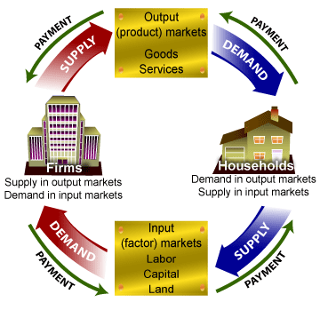

Slide 33
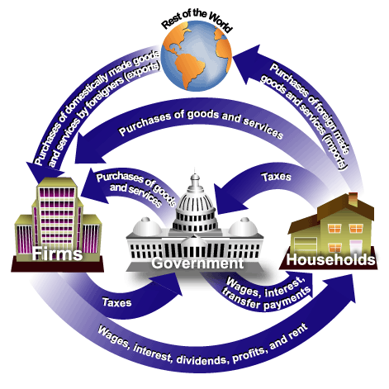
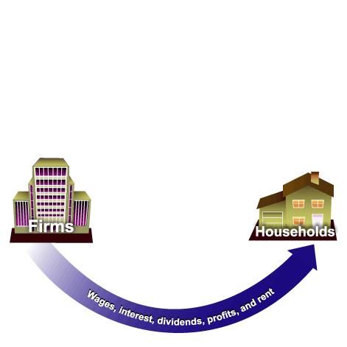
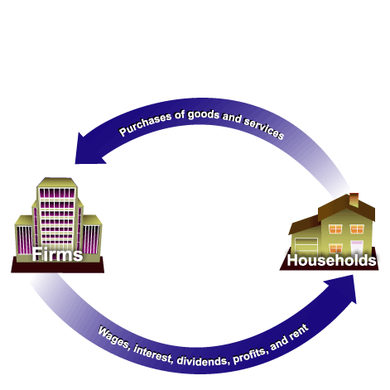
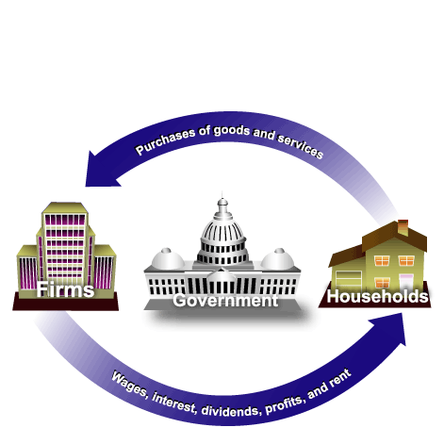
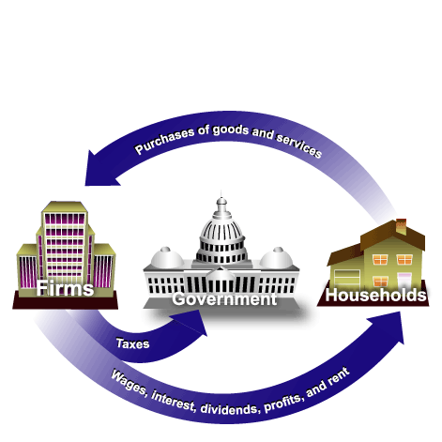
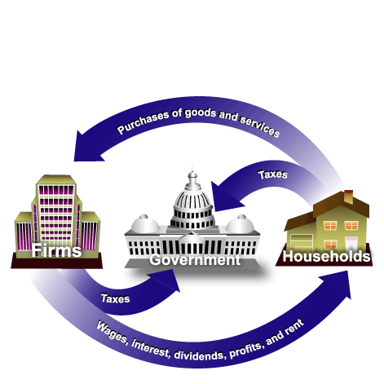
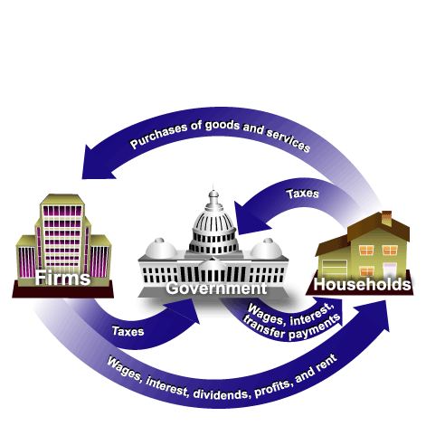
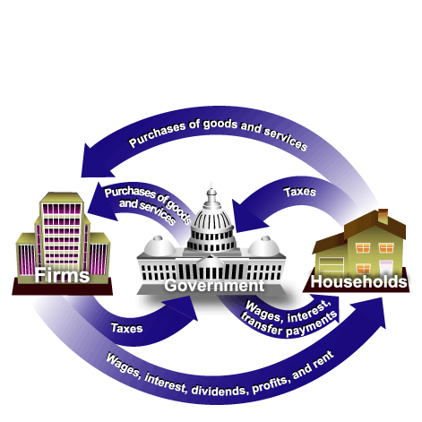
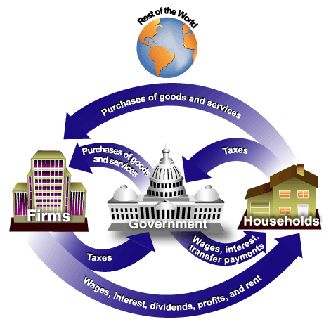
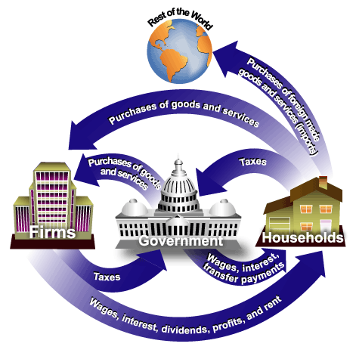

Slide 34
CIRCULAR FLOW OF INCOME
COMPONENTS OF CFI:
Household
Firm

Slide 35
CIRCULAR FLOW OF INCOME
It also consists of :
Inner flows
Outer flows

Slide 36
INNER FLOW
Firms pay households in the form of wages & salaries
Dividend on shares
Interest on rent
Consumers pay for the goods and services consumed.

Slide 37
OUTERFLOWS
Include:
Injections----eg. Investment (I), Government. spending, export revenues
Withdrawals----eg. Net savings, Government. taxes & import expenditures

