Slide 1
DRY-BULK MINERAL COMMODITY GROUPS
By
Mark Butler

Slide 2
BULK-CARGO FACILITIES
Bulk-cargo facilities include:
dry-bulk terminals for handling such products as metal ores (copper, iron, antimony, tin, manganese, aluminum ore, bauxite), coal, coke, cement clinkers, and dry chemical products, such as soda ash, salt, sugar, alumina silica, sulphur, and chemical fertilizers

Slide 3
DRY-BULK CARGO
Dry-bulk cargo is customary divided into two groups.
major bulk cargoes
minor-bulk cargoes

Slide 4
DRY-BULK CARGO
The major bulk cargoes in order of tonnage shipped are:
Coal and Coke
Iron Ore
Grain and Oil Seeds
Bauxite and Alumina
Phosphates

Slide 5
COAL
Coal has a stowage factor that varies between 1.00 and 1.40 cubic meters per tonne.
All types of coal, even anthracite, are subject to spontaneous combustion caused by heating of the coal as it absorbs oxygen from the air.

Slide 6
COAL
Coal is a mineral that can be used as solid fuel and as a raw material for coke, gas manufacturing, briquettes, and tar. Coal is an important supplier of energy. Unsorted coal, which comes directly from the mines, is called forder coal. It is mixed with much stone.

Slide 7
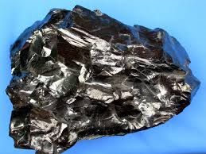
COAL
The following types of coal are distinguished:
Anthracite
This shiny coal is the hardest and oldest and is very rich in carbon.

Slide 8
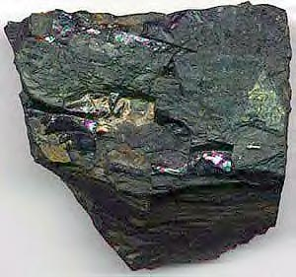
COAL
Bituminous
The next oldest is bituminous coal (sometimes called fat coal) which is softer and dull.

Slide 9
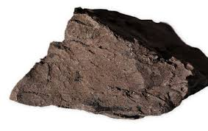
COAL
Lignite (brown)
The youngest coal is very soft—somewhere between peat and bituminous coal.

Slide 10
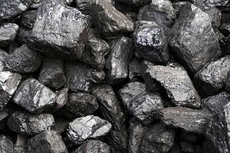
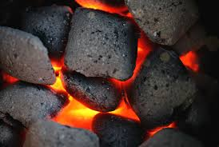
COAL
Gas coal
Also called thermal coal; this is used for energy production at power stations.

Slide 11
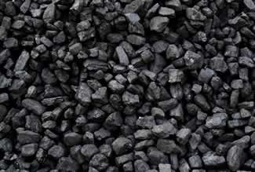
COAL
Coking coal
This coal is used in steel production furnaces.

Slide 12
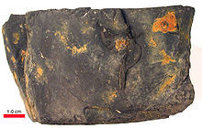
COAL
Cannel coal
a bituminous coal which is hard and dull (77– 80% carbon), used for making gas.

Slide 13
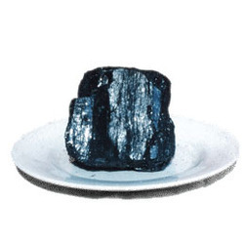
COAL
Lean coals are hard and glossy

Slide 14
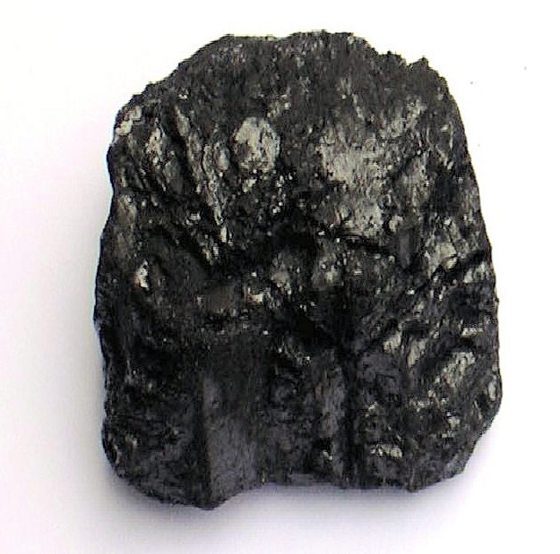
COAL
Fat coals
Are soft and are used for coke and in foundries.

Slide 15
COAL
Coal is also classified by the dimensions of the pieces as follows:
fine coal: up to 4 mm diameter
slack: from 5 to 9 mm
nuts: from 10 to 80 mm. A number from 5 to 1 indicates the relative diameter:
nuts 5 are the smallest
nuts 1 are the biggest

Slide 16
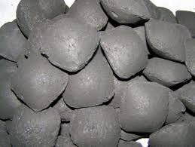
COAL
Briquettes are made from a mixture of fine coal and coal-dust mixed with tar. The coal-dust of lean coal mixed with binding agents produces egg-shaped coal (ovoids).

Slide 17
COKE
Coke is coal with the gas taken out.
Coke, known as petroleum coke (petcoke), is also produced by the carbonization of crude oil
This happens during strong heating in a closed furnace, without air, so without combustion.
This process is called carbonization..

Slide 18
LOADING AND DISCHARGING
During loading and discharging care has to be taken not to dump coal from a great height. This causes breakage of the coal. If this results in much breakage, than there is a chance of gas formation in the cargo of coal. At the same time, the possibility of heating exists. Breakage also causes a decrease in quality.

Slide 19
COAL VS COKE
Coal and coke are common fuels used for household and industrial combustion purposes. Both are present in the natural environment. However, coke is produced by man for the excessive usage

Slide 20
COAL VS COKE
Coal
Coal is a fossil fuel similar to natural gas and oil, which is in a solid rock form.
Coal is formed by accumulating plant debris in swamps.
The process takes thousands of years.
When plant materials collect on swamps, they degrade very slowly.

Slide 21
COAL VS COKE
Main economic usage of coal is to produce electricity.
By burning coal, heat is obtained and then this heat energy is used to produce steam.
Finally, electricity is produced by running a steam generator.

Slide 22
COAL VS COKE
Coke
Coke is a naturally found carbonaceous solid, but it can be made by man too. Man-made coke is used commonly.
Coke has a hard, porous structure, and it is grey in color. It is produced from bituminous coal.

Slide 23
COAL VS COKE
Coal is baked in an airless furnace at a very high temperature (above 2000 degrees Celsius) to remove water, gas and coal-tar, and at the end of the coking process, it contains zero amount of water. However, later small amount of water can be absorbed by the porous structure.

Slide 24
COAL VS COKE
Coke is useful as a fuel in stoves and furnaces. It burns with no smoke; therefore, better as a fuel than bituminous coal itself. Coke is also used as a reducing agent in smelting iron ore.

Slide 25
ORE
An ore is a naturally occurring material containing one or more extractable, economically valuable minerals.
The term also refers to the minerals thus extracted. Most often the term refers to material containing metallic elements, such as iron ore or copper ore.

Slide 26
ORE
Ores are an important bulk good. Each mineral, out of which can be won a metal in an economic way is called an ore. Ores are extracted underground as well as at the surface of the earth (strip mining).

Slide 27
ORE
Iron Ore
Iron (Fe) is one of the most abundant rock-forming elements, constituting about 5% of the Earth's crust. It is the fourth most abundant element after oxygen, silicon and aluminums, and after aluminum, the most abundant and widely distributed metal.

Slide 28
ORE
Iron ores are rocks from which metallic iron can be economically extracted. These rocks are usually found in the form of hematite (Fe₂O₃) or magnetite (Fe₃O₄). About 98% of world iron ore production is used to make iron in the form of steel.
Iron ore is a mineral block which may be found underground. It is the most common mineral which may be used to make tools and armor.

Slide 29
ORE
Iron ore is the most important dry-bulk commodity in international sea-borne trade. Iron ore includes ores such as magnetite, hematite, limonite, siderite, and roasted iron pyrites.

Slide 30
ORE
The ore shipped has a stowage factor, which varies between 0.30 and 0.80 cubic meters per ton. Iron ore is always transported in bulk and in full shiploads.

Slide 31
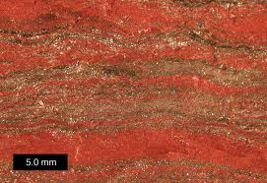
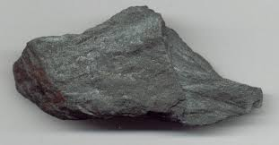
ORE
Several types of ore are distinguished, iron ore with a red colour is richest in iron, and iron ore with a grey-black colour the poorest.

Slide 32
PITCH
Pitch is a name for any of a number of viscoelastic, solid polymers. Pitch can be made from petroleum products or plants. Petroleum-derived pitch is also called bitumen or asphalt. Pitch produced from plants is also known as resin. Some products made from plant resin are also known as rosin.

Slide 33
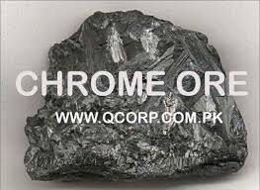
Chrome Ore
Unprocessed chrome ore may contain only a few percent of chrome. It is also shipped as a concentrate, when the grade of chrome may be up to 50%. Chrome ore is the main ingredient in the production of ferro-chrome and it is used for protective coatings

Slide 34
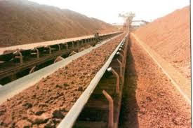
BAUXITE
Bauxite ore when processed into alumina is the basic raw material for the production of aluminum (aluminium). Some 4 or 5 tonnes of bauxite produces 2 tonnes of alumina, which produces 1 tonne of aluminum.

Slide 35
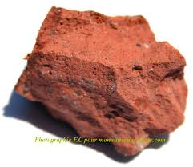
BAUXITE
The ore consists of rocks that have been weathered in a tropical climate with alternating dry and wet seasons. The name of bauxite originates from Les Beaux in France.

Slide 36
BAUXITE
The integrated structure of the world’s aluminum industry results in many terminals being owned and operated by industry. These commodities, particularly alumina, are dusty and require precautions against plant and area pollution.

Slide 37
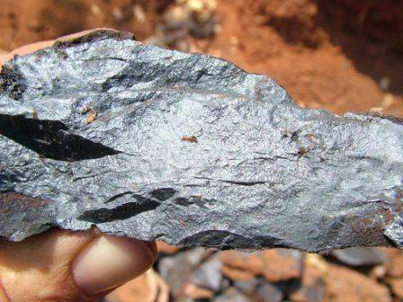
MANGANESE ORE
Manganese is a high-grade type of metal. In pure form, it looks like iron, but it is harder.
When the ore contents amounts more than 30% of manganese, than it is called manganese ore.
When the grade lies between 12% and 30% than it is called manganese iron ore.

Slide 38
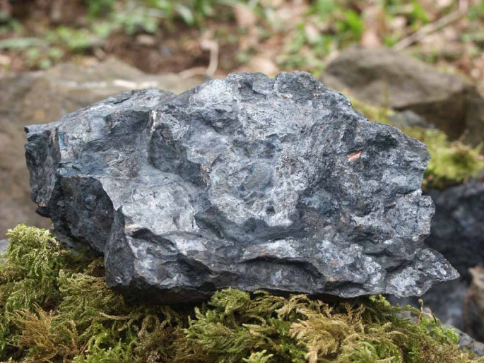
MANGANESE ORE
When the percentage is lower than 12% than it is called manganiferous ironore.
Manganese is used in the steel industry. It raises the toughness, the hardness, and the weldability of steel.

Slide 39
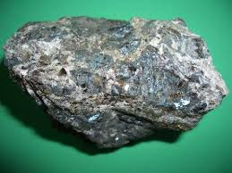
Zinc Ore
Zinc ore, also called zinc blend, is a raw material for zinc.
It is rather easy to separate from the ore. It is one of the cheapest metals.
The grade of zinc may be 50%. It is mostly shipped in concentrated form. Zinc is often used for alloys,

Slide 40
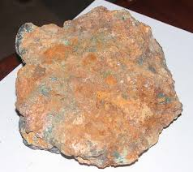
COPPER ORE
The copper grade varies between 1% and 7%. It is shipped as concentrate. The characteristic colour is red. Copper alloys include brass (yellow copper), which is an alloy of copper and zinc, and bronze, which is an alloy of copper and tin.

Slide 41
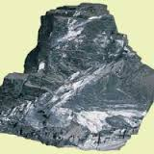
TIN ORE
Tin is a white glossy metal, which is found in granite. It is used for solder, tinfoil, and various alloys

Slide 42
Iron and Steel Scrap
Scrap consists of cut pieces of rail, beams, plates, and other waste of steel factories.
The big producers of this scrap are the railway, shipbuilding, and breakers' yards.

Slide 43
Pig Iron
This is crude iron, which is extracted from blast furnaces. The crude iron exists in many variations, depending of the other chemical materials, which it contains.

Slide 44
Cement
The manufacture of Portland cement was started under licence granted in 1949.
Limestone, the major raw material.
There are two basic methods of transporting cement by sea. In bags or in bulk.

Slide 45
Terminal Design and Layout
Radical differences exist between the character of dry-bulk cargo terminals, especially those designed to handle mineral ores, and the average all-purpose commercial port.
The requirements with respect to location, depth of water, type of infrastructure, layout, equipment, storage facilities.

Slide 46
Unlike in a general cargo port, a terminal used for the exporting of mineral ores does not need to be located close to the main centres of commercial and industrial activity.
Bulk carriers require huge stocks of ore at the terminal and therefore extensive storage facilities are required

Slide 47
To achieve the required speeds of loading, a network of belt conveyors is needed, linking powerful reclaimers to ship loaders.
The storage area on land requires the proper equipment for unloading vehicles from the mines, for stacking the ores on the stockpiles, and for reclaiming ore for delivery by belt conveyor to the ship-loader.

Slide 48
Safety and Security in Dry-Bulk Terminals
Before anyone enters a dry-bulk terminal, they have to be acquainted with safety rules and regulations, because of the many risks
When cargo is hoisted, pieces of ore or coal may
fall from the grab, so never walk underneath a hoisted grab.

Slide 49
Personnel safety equipment
safety helmets (hard-hat protection)
safety shoes and boots
Gloves
bright-coloured clothes and/or reflective tape

Slide 50
masks to protect against dust
goggles
skin protection—ointment or talcum powder, especially when handling pitch and pitch coal.

Slide 51
Danger Notices
observe notices indicating where to walk
know where the safety lines are that stop the conveyor belts
heed warning signals, either as sound, light signals, or messages sent by port phone or intercom especially to persons working with big machines like bulldozers and big cranes
if you intend to work in the vicinity of heavy equipment, report to the operator
know the locations of first aid stations

Slide 52
look out for shunting of railway cars when working with grabs into a railway car. Do not walk close, because side doors may be pushed open by the grab, or falling overflow
never come too close to big-wheeled machines because pieces of ore may be flung out of the tire profile be careful not to slip. Slippery areas may be created by rain or damp weather conditions; by cargoes like china clay; and on places where dust precipitates. In addition, when ballast water is pumped out of the ship alongside the terminal and the water is pumped by accident on to the terminal
be aware that ship’s hawsers and mooring lines may break with very dangerous consequences.

