Slide 1
UNIT THREE
THE GENERAL JOURNAL & SUBSIDIARY BOOKS

Slide 2
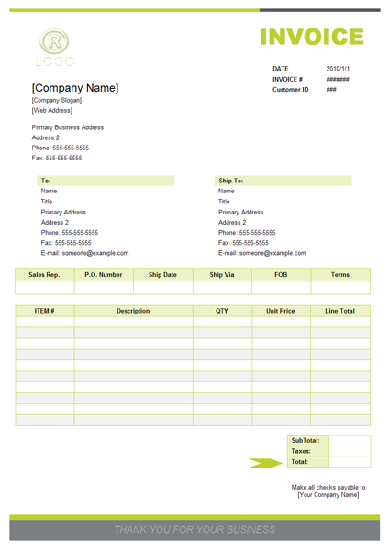
SALES RECEIPTS

Slide 3
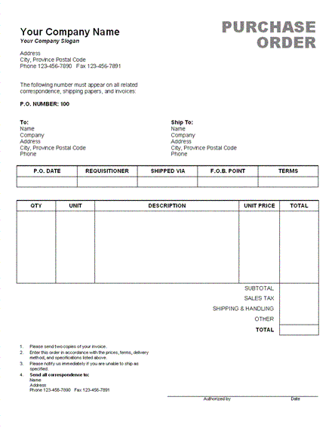
PURCHASE RECEIPT

Slide 4
JOURNAL PROCESS FLOW
After the transactions are recorded in these journals, you
"post" the summary of all the transactions in each journal
to the general ledger, which contains all of a company's
accounts. An account is a separate, detailed record
associated with a specific asset, liability, equity, revenue,
or expense item. Examples of accounts are:
Accounts Receivable (an asset account)
Accounts Payable (a liability account)
Retained Earnings (an equity account)
Product Sales (a revenue account)
Cost of Goods Sold (an expense account)

Slide 5
GENERAL JOURNAL
The general journal is part of the accounting
record keeping system. When an event occurs
that must be recorded, it is called a
transaction, and may be recorded in the
general journal or in a specialty journal.

Slide 6
TRANSACTIONS RECORDED IN THE GENERAL JOURNALS
Examples of transactions recorded in the general
journal are:
Asset sales
Depreciation
Interest income and expense
Common stock sales
Once entered, the general journal provides a chronological record
of all non-specialized entries that would otherwise have been
recorded in one of the specialty journals.

Slide 7
EXAMPLE OF GENERAL JOURNAL An example of general journal transaction: business depreciated its assets in 2012
An example of a journal entry that would be recorded in the general journal is:
Date | Account | Debit | Credit
Dec 30, 2012 | Depreciation expense | 10,000
 | Accumulated depreciation |  | 10,000
 | To record depreciation for the year 2012

Slide 8
EXAMPLE OF GENERAL JOURNAL An example of general journal transaction: business purchased three motor cars.
An example of a journal entry that would be recorded in the general journal is:
Date | Account | Debit | Credit
Dec 30, 2012 | Motor car | $900
 | Cash |  | $900
 | To record the purchase of motor cars in 2012

Slide 9
Journal Entry 1 -- Paul forms the corporation by purchasing 10,000 shares of $1 par stock
Journal Entry 1 -- Paul forms the corporation by purchasing 10,000 shares of $1 par stock.

Slide 10
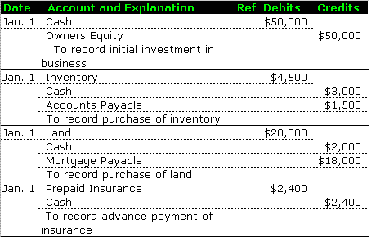
OTHER EXAMPLES OF JOURNAL ENTRIES

Slide 11
EXAMPLES OF ENTRIES TO JOURNALIZE
The company started business on June 6, 2013.
The business was started with $300,000. The
transactions they engaged in during their first
month of business are below:
June 8 An amount of $50,000 was paid for six months of rent.
June 9 Equipment costing $100,000 was purchased using $40,000 cash. The remaining amount of $60,000 is a one year note with an interest rate of 3.4%

Slide 12
June 10 Office supplies were purchased totaling $25,000 on account.
June 16 Received $39,400 in cash for services rendered to customers.
June 16 Paid the account for office supplies purchased June 10.
June 20 $63,900 worth of services were given to customers. Received cash amount of $43,700. Customers promised to pay remaining amount of $20,200.
June 21 Paid employees’ wages for June 8-June 21. Wages total $23,500.

Slide 13
SUBSIDIARY BOOKS
Most of the big companies are
recording the business transactions in
one journal and the posting of the
same to the concerned ledger
accounts are very difficult tasks and
which require more clerical labor
also.

Slide 14
For avoiding such kind of
difficulties most of the business
organizations are subdividing the
journal in to subsidiary journals
or subsidiary books.

Slide 15
SUBSIDIARY BOOKS
Subsidiary books are those books of
original entry in which similar nature
of transactions are recording in a
chronological order. There are
different kinds of subsidiary books.

Slide 16
They are so named because record
specific types of routine transactions are
recorded in them.
EXAMPLES:
purchase day book or purchase Journal
Sales day book or sales journal
purchase returns book

Slide 17
Sales returns book
Bills receivable books or cash receipts journal
Bills payable books or cash disbursement journal
Cash book.

Slide 18
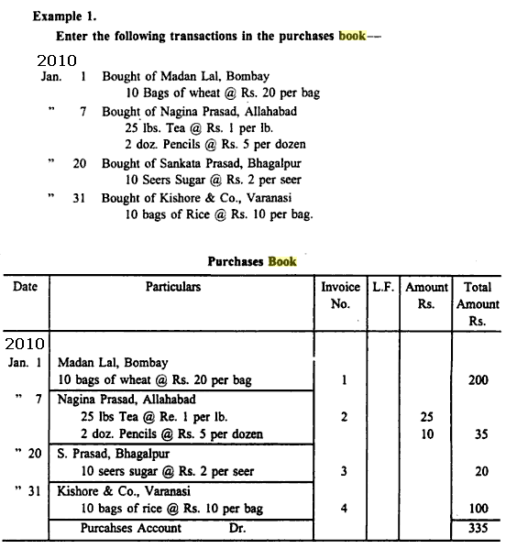
PURCHASE DAY BOOK OR PURCHASE JOURNAL

Slide 19
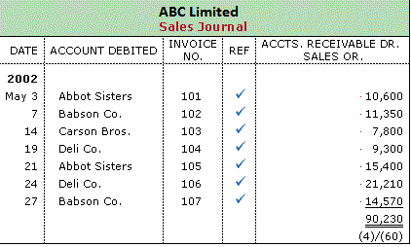
SALES DAY BOOK OR SALES JOURNAL

Slide 20
PURCHASE RETURNS BOOK
The following Returns Outwards transactions
are Journalised below:
2009
July 9 Goods returned to Karnot Webb $40
July 14 Returned goods to Harlot Mcqueen $50
July 31 Returns Outwards to Clement Rhoden $60

Slide 21
PURCHASE RETURNS BOOK

Slide 22
Example: Sale return/return inwards
The following balances were outstanding by debtors on
31May 2004.
A.Sin $188 C.Chung $88 S.Tin $118
The following transactions took place during June 2004:
2004
Jun 10 Goods returned to us by: A.Sin $12 ; C.Chung $17
Jun 24 Goods returned to us by S.Tin $5

Slide 23
Returns Inwards Journal
Date 2004 | Details | Folio | Amount $
Jun 10 A.Sin
SL1
12
10 C.Chung
SL2
17
24 S.Tin
SL3
5
30 Transferred to returns inwards account
GL1
34
Sales Ledger
A.Sin
1
C.Chung
2
2004 $
Jun 1 Bal b/d 188
2004 $
Jun 10 Returns 12
Inwards
2004 $
Jun 1 Bal b/d 88
2004 $
Jun 10 Returns 17
Inwards
General Ledger
S.Tin
3
Returns Inwards
1
2004 $
Jun 1 Bal b/d 118
2004 $
Jun 24 Returns 5
Inwards
$
Jun30 Returns for 34 the month

