Slide 1
UNIT THREE
THE GENERAL JOURNAL & SUBSIDIARY BOOKS
ADDITIONAL SLIDES

Slide 2
CASH RECEIPT JOURNAL
The Cash Receipts Journal is used to record
sales of merchandise for cash. (Credit sales
are not recorded here, they belong in the sales
journal).
All transactions in the cash receipts journal involve
the receipt of cash, so you'll find a column for
debiting cash (Cash DR.). There is also a debit
column for sales discounts in case the transaction
involves a sale that is discounted.

Slide 3
CASH RECEIPTS JOURNAL EXAMPLES
Consider the following four examples for your
cash receipts journal:
Customer A sends a check for a prior sale, paying $10,357.55 and taking a $102.55 sales discount;
You make a cash sale for $452
Customer B sends a check for a prior sale, paying $6,120
You are paid $3,000 in principal and $155 in interest on a note.

Slide 4
POSTING FROM THE CASH RECEIPTS JOURNAL
The column values are posted in their own separate
ways:
Transactions from the Other Accounts column should be posted individually in the general ledger (The account number for the general ledger account is placed in the posting column of the Cash Receipts Journal).
Cash Sales recorded in the Cash Receipts Journal should be posted as a single Sales credit total in your general ledger.

Slide 5
Like cash sales, sales discounts should be posted as a single Sales Discounts credit total in your general ledger.
Cash should be posted as a single debit total in your general ledger.
When you record cash payments towards accounts receivables, you should post individual transactions as credits to the customer accounts in the accounts receivable ledger.

Slide 6
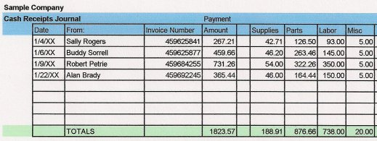
EXAMPLE OF CASH RECEIPT JOURNAL

Slide 7
CASH DISBURSEMENT JOURNAL
Definition of 'Cash Disbursement Journal'
A record kept by accountants to record all financial expenditures made by a company. Cash disbursement journals serve a number of functions, such as a source for recording tax write-offs and the categorization of other expenses. This journal essentially functions as a check book ledger, for all practical purposes.

Slide 8
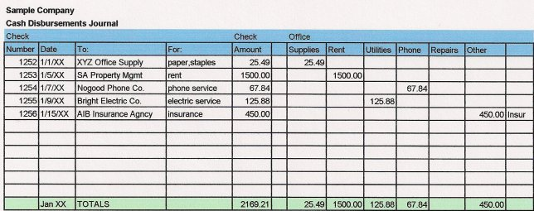
EXAMPLE OF CASH DISBURSEMENT JOURNAL

Slide 9
CASH BOOK
Journal in which all cash receipts and payments
(including bank deposits and withdrawals) are
recorded first, in chronological order, for
Posting to general ledger. Cash book is
Regularly reconciled with the bank
statements as an internal auditing measure.

Slide 10
In larger firms, it is commonly divided into
two parts:
(1) Cash disbursement journal in
which all cash payments (such as accounts
payable, operating expenses, petty
cash purchases) are recorded
(2) Cash receipts journal in which all cash
receipts (such as accounts receivable,
cash sales, sale of assets) are recorded.

Slide 11
The cashbook and ledger enjoy what can be
considered a confusing relationship because
the cashbook actually serves as a ledger. In
companies that handle a large amount of cash
debit and credit transactions, the cashbook
takes the place of a separate cash account in
the main company ledger. Businesses with
fewer cash payments and receipts may not
require a cashbook and choose to use a cash
account only.

Slide 12
CASH BOOK
Cash book is a book of original entry in which transactions relating only to cash receipts and payments are recorded in detail. When cash is received it is entered on the debit or left hand side. Similarly, when cash is paid out the same is recorded on the credit or right hand side of the cash book.

Slide 13
CASH VOUCHER
For Every entry made in the cash book there must be a proper voucher. Vouchers are documents containing evidence of payment and receipts. When money is received generally a printed receipt is issued to the payer but counterfoil or the carbon copy of it is preserved by the cashier. The copy receipts are called debit vouchers, and they support the entries appearing on the debit side of the cash book.

Slide 14
..
Similarly when payment is made a receipt is obtained from the payee. These receipts are known as credit vouchers. All the debit and credit vouchers are consecutively numbered. For ready reference the number of the vouchers are noted against the respective entries. A column is provided on either side of the cash book for this purpose.

Slide 15
BALANCING CASH BOOK
The cash book is balanced at the end of a given period by inserting the excess of the debit on the credit side as "by balance carried down" to make both sides agree. The balance is then shown on the debit side by "To balance brought down" to start the next period. As one cannot pay more than what he actually receives, the cash book recording cash only can never show a credit balance.

Slide 16
TYPES OF CASH BOOK
The different forms of cash book are as follows:
a. Simple Cash book – This is the simple form of cash book.
b. Two column cash book – This type of cash book have two columns like cash column and discount column.
c. Three column cash book – This involves three columns such as Bank column, cash column and discount column.
d. Petty cash book - This is used to record petty expenses like postage, cartage, printing and stationery etc in the day to day business activities.

Slide 17
SIMPLE CASH BOOK
Records only cash receipts and payments. It has only one money column on each of the debit and credit sides of the cash book. All the cash receipts are entered on the debit side and the cash payments on the credit side.

Slide 18
POSTING
The balance at the beginning of the period is not posted but other entries appearing on the debit side of the cash book are posted to the credit of the respective accounts in the ledger, and the entries appearing on the credit side of the cash book are posted to the debit of the proper accounts in the ledger.

Slide 19
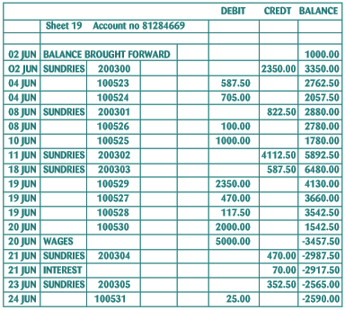
SIMPLE CASH BOOK

Slide 20
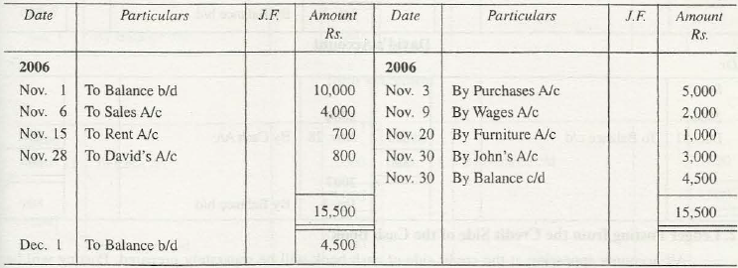

Slide 21
Write the following transactions in the simple cash book and post into the ledger:
1991
Jan. 1 | Cash in hand | 15,000
" 6 | Purchased goods for cash | 2,000
" 16 | Received from Akbar | 3,000
" 18 | Paid to Babar | 1,000
" 20 | Cash sales | 4,000
" 25 | Paid for stationary | 60
" 30 | Paid for salaries | 1,000
" 31 | Purchased office furniture | 2,000

Slide 22
TWO COLUMNAR CASH BOOK
One which consists of two separate columns on the debit side as well as credit side for recording cash and discount. In many concerns it is customary for the trader to allow or to receive small allowance off or against the dues. These allowances are made for prompt settlement of accounts. In certain business almost all receipts or payments are accompanied by such discounts and in order to avoid unnecessary postings separate columns in the cash book are introduced to record the discounts received or allowed

Slide 23
TWO COLUMNAR CASH BOOK
The recording of two columnar transactions will be
more clearer with following illustration.
Jan 1 Cash Balance 5,000.00
Jan 6 Sale goods to ABC 4,000.00
Jan 8 Purchased goods from XYZ 3,000.00
Jan 15 Cash received from ABC 3,900.00 in full satisfaction
Jan 20 Paid to XYZ 2,830 in full satisfaction
Jan 25 Sold goods to EFG 3,000.00
Received cash from EFG 2,900.00 in full satisfaction

Slide 24
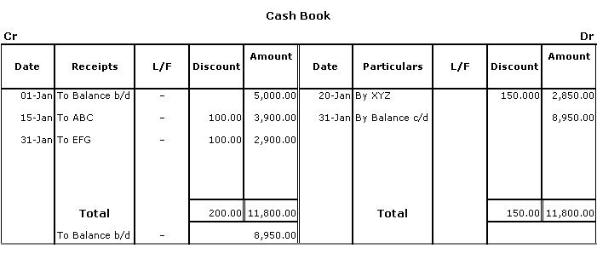
TWO COLUMNAR CASH BOOK

Slide 25
KINDLY REVISE THE THREE COLUMN CASH BOOK

