Slide 1
BUSINESS ACCOUNTING
UNIT ONE
INTRODUCTION TO ACCOUNTING

Slide 2
WHAT IS ACCOUNTING?
Accounting is an information science
used to collect, classify, and
manipulate financial data for
organizations and individuals.
Accounting is instrumental within an
organization for several reasons:

Slide 3
determination of company’s financial stability
determination of an organization’s overall
wealth
profitability and liquidity
Without accounting, organizations would
have no basis or foundation upon which daily
and long-term decisions could be made.

Slide 4
The budgets for marketing activities,
profit reinvestment, research and
development, and company growth
all stem from the work of accountants.

Slide 5
Accounting is one of the oldest and
most respected professions in the
world, and accountants can be found
in every industry {legal or
illegal}from entertainment to
medicine.

Slide 6
THE IMPORTANCE OF FINANCIAL ACCOUNTING
Financial accounting, which some
call "the language of business," is
important to companies of any size.
Its importance surrounds:

Slide 7
Recording Transactions
Communicating Information -- External
Communicating Information -- Internal
Analysis and Comparison

Slide 8
USERS OF ACCOUNTING INFORMATION
Internal users (Primary Users) of accounting
information include the following:
MANAGEMENT
EMPLOYEES
OWNERS

Slide 9
External users (Secondary Users) of
accounting information include the
following:
CREDITORS
TAX AUTHOURITIES
INVESTORS
CUSTOMERS
REGULATORY AUTHORITIES

Slide 10
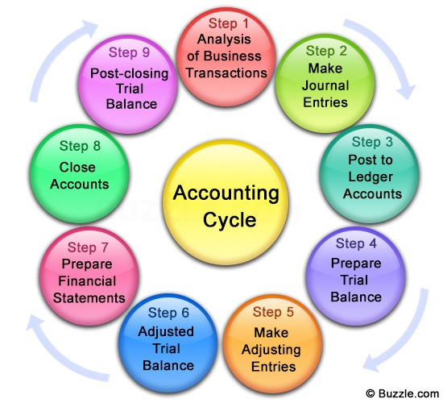
THE ACCOUNTING CYCLE

Slide 11
Accounting cycle is the financial process
starting with recording business
transactions and leading up to the
preparation of financial statements.
This process demonstrates the purpose of
financial accounting--to create useful financial
information in the form of general-purpose
financial statements.

Slide 12
THE ACCOUNTING EQUATION

Slide 13
DISTINCTION BETWEEN ASSETS, LIABILITIES & CAPITAL
ASSETS are a company's resources—things the
company owns. Examples of assets include
cash, accounts receivable, inventory, prepaid
insurance, investments, land, buildings,
equipment, and goodwill. From the
accounting equation, we see that the amount of
assets must equal the combined amount of
liabilities plus owner's (or stockholders') equity.

Slide 14
LIABILITIES are a company's obligations—amounts
the company owes. Examples of liabilities include
notes or loans payable, accounts payable, salaries
and wages payable, interest payable, and income
taxes payable (if the company is a regular
corporation). Liabilities can be viewed in two
ways:
as claims by creditors against the company's
assets
a source—along with owner or stockholder
equity—of the company's assets

Slide 15
OWNER'S EQUITY or stockholders' equity is the amount left over after liabilities are deducted from assets:
Assets - Liabilities = Owner's (or Stockholders') Equity.
Owner's or stockholders' equity also reports the amounts invested into the company by the owners plus the cumulative net income of the company that has not been withdrawn or distributed to the owners.

Slide 16
BALANCE SHEET
A financial statement that summarizes acompany's
assets, liabilities and shareholders' equity at a
specific point in time.
These three balance sheet segments give investors an idea as to
what the company owns and owes, as well as the amount
invested by the shareholders.
The balance sheet must follow the following formula:
Assets = Liabilities + Shareholders' Equity

Slide 17
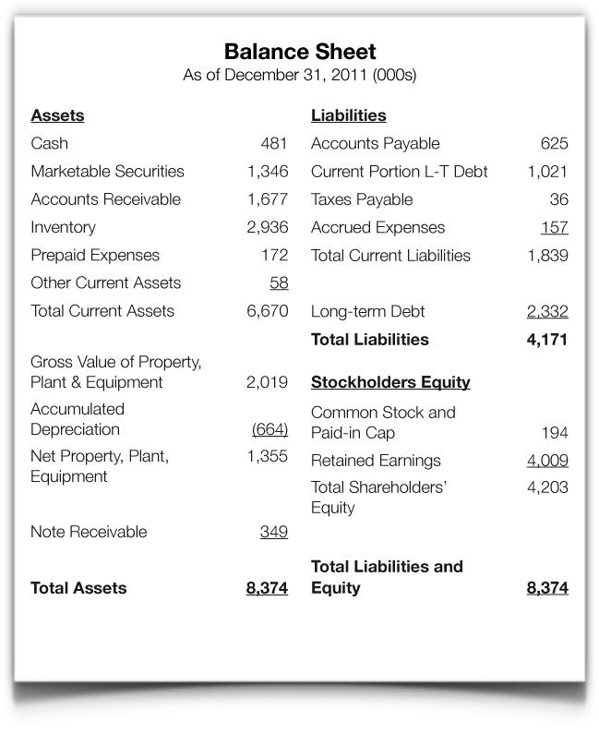

Slide 18
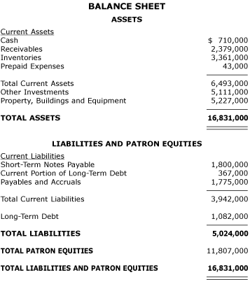

Slide 19
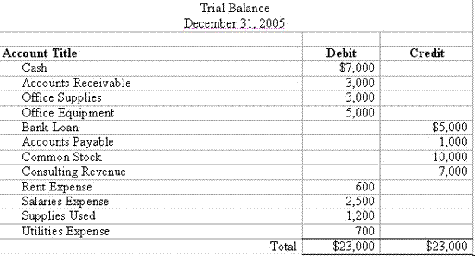
EXAMPLE OF A TRIAL BALANCE
Example Trial Balance:

