Slide 1
Ancillary Services
UNIT 10

Slide 2
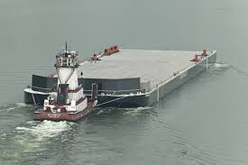
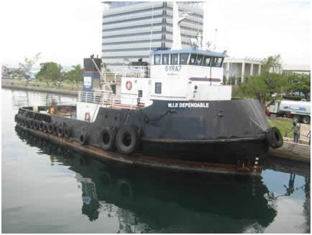
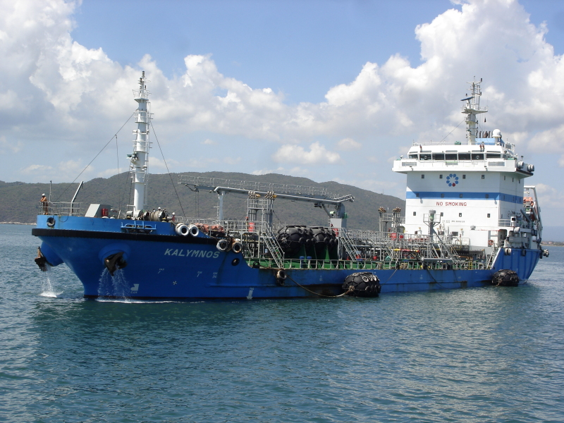
Bunkering

Slide 3
Bunkering
Bunkers has a unique meaning in international shipping. The term is universally understood to mean FUEL for vessels.
Therefore: Bunkering is the receipt of fuel by ships.

Slide 4
Choice of Bunkering Ports
During a voyage, bunkers and water are continually used. Sufficient bunkers and water must be carried for each leg of the journey, but this must be balanced with the need to maximize revenue-producing cargo.
Overall weights that can be carried are limited by the need to respect legal load lines that depend on the location and season.

Slide 5
There is no hard and fast rule about where bunkers should be replenished. It is in the shipowner’s interest to run each voyage as efficiently as possible, minimizing time and costs while maximizing revenues.

Slide 6
What to Look for when choosing Bunkering Ports
Bunker Price
Geographical Advantage
Port Bunker Fuel Capacity
Supply Waiting Time
Bunker Quality
Safety of Bunkers
Bunker Suppliers

Slide 7
What to Look for when choosing Bunkering Ports
Bunkering supply regulations
Port Tariffs
Port weather conditions
Efficiency of bunker supply
Environmental restrictions
Port time

Slide 8
Ship chandler

Slide 9
Ship chandler
A dealer in sails and ropes and other supplies for sailing ships chandler - a retail dealer in provisions and supplies.

Slide 10
A ship chandler is a merchant who deals in supplies for ships, including everything from cruise ships to oil tankers. For sailors, a chandlery provides a one-stop shop to meet basic needs in port, allowing people to quickly supply a ship so they can turn it around and go back out to sea.

Slide 11
The ship chandler stocks a wide variety of goods, including food, cleaning supplies, marine electronics, and other sundries people may need to smoothly run a ship. The merchant relies on a variety of local sources to keep goods in stock and often accepts credit or foreign currency to make it easier for ships to quickly meet their supply needs.

Slide 12
Ships can place an order with a ship chandler before arriving in port so the chandler can get ready for the ship's arrival. This will cut down on loading and turnaround time by allowing representatives of the chandler to immediately start stocking the ship once it docks.

Slide 13
This work requires a knowledge of the shipping industry and familiarity with the needs of various kinds of ships. Ship chandlers also need to establish and maintain good relationships with wholesalers in their region to access the supplies and services they need. Awareness of the competition is also part of the job;

Slide 14
TUG BOATS

Slide 16
A tugboat (tug) is a boat that maneuvers vessels by pushing or towing them. Tugs move vessels that either should not move themselves, such as ships in a crowded harbor or a narrow canal.

Slide 17
Tugboats are powerful for their size and strongly built, and some are ocean-going. Some tugboats serve as icebreakers or salvage boats. Early tugboats had steam engines, but today most have diesel engines. Many tugboats have firefighting monitors, allowing them to assist in firefighting, especially in harbors.

Slide 18
Dry dock is a large dock made out from the shore, from which water can be pumped out in order to repair parts of the ship which are below the waterline. According to a SOLAS requirement, every sea going ship should be dry docked at least twice every 5 years.

Slide 19
Dry docks should also be carried out if demanded by the Classification Society. This is usually asked to be done in case the ship has met with a collision, has been grounded in past or has a lousy maintenance practice. Inspection during dry docking is also carried out if the ship is to be sold.

Slide 20
Dry dock method
The type of Dry docking method selected depends on the type of the ship and the severity of maintenance and repair required. The four main types of Dry docking Methods are as follows:
Floating Dock
Excavated Dock
Patent Slip
Ship lift

Slide 21
A Floating Dock is a kind of a pontoon with sponsons on both the sides. The pontoon is divided into number of tanks. When the ship has to be docked, the tanks are filled with water due to which the dock submerges into the water. The ship is then navigated into the dock and the tanks are emptied so that the dock rises above the water.

Slide 22
The pumping of water is done with the help of ballast pumps which are located in sponsons. The sponsons are also equipped with cranes and bollards. Both the sponsons are connected with a bridge. Apart from the ballast pumps, the water is also filled manually with the help of manual valves.

Slide 24
Excavated dock
This method of docking is almost similar to that of Floating dock. The Only difference is that it has a closing door at the opening. Also, the dock is sloped slightly towards the opening and the ballast pumps are located near the door itself. Excavated dock can be a floating structure or a dock at the harbour.

Slide 25
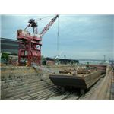

Slide 26
Patent ship
This system is generally used for small ships of length 140 meters or less. It works some thing like the "jack up" system. The system consists of cradles that moves with the help of rails. The cradles roll into the water till they reach exactly beneath the ship. Once there, they are pulled in a perpendicular direction which brings the ship above the water surface.

Slide 28
Ship lift
This system is somewhat similar to the Patent Ship method. It also consists of cradles which are used to slid a platform into the water, below the ship. Once the platform reaches below the ship, the ship is properly navigated on the platform

Slide 29
After that, Winches are used to lift the ship and to place it in the desired position. This system can lift ships only of length up to 125 meters. Approximately 14 cradles are used to move the platform.

